Slide 1
Travel Application
And
Code Playground Application
Name: Ravi Teja Kuchipudi
Batch: Wipro Salesforce B13 (WIP-SF-13)
LMS Id: MGSA_519
Date: 27/02/2023

Slide 2
Module - 1

Slide 3
Exercise - 1
Build a Lightning app and add tabs.
Create custom objects, fields and define relationship between Objects.
Import Data.
Test the app.

Slide 4
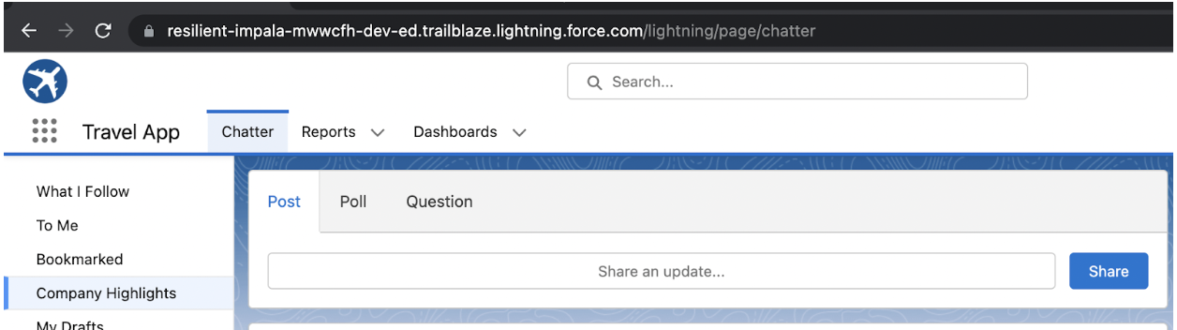
Build a Lightning app and add tabs.
A Custom App with name Travel App is created.
Chatter, Reports and Dashboards are added to Navigation items

Slide 5
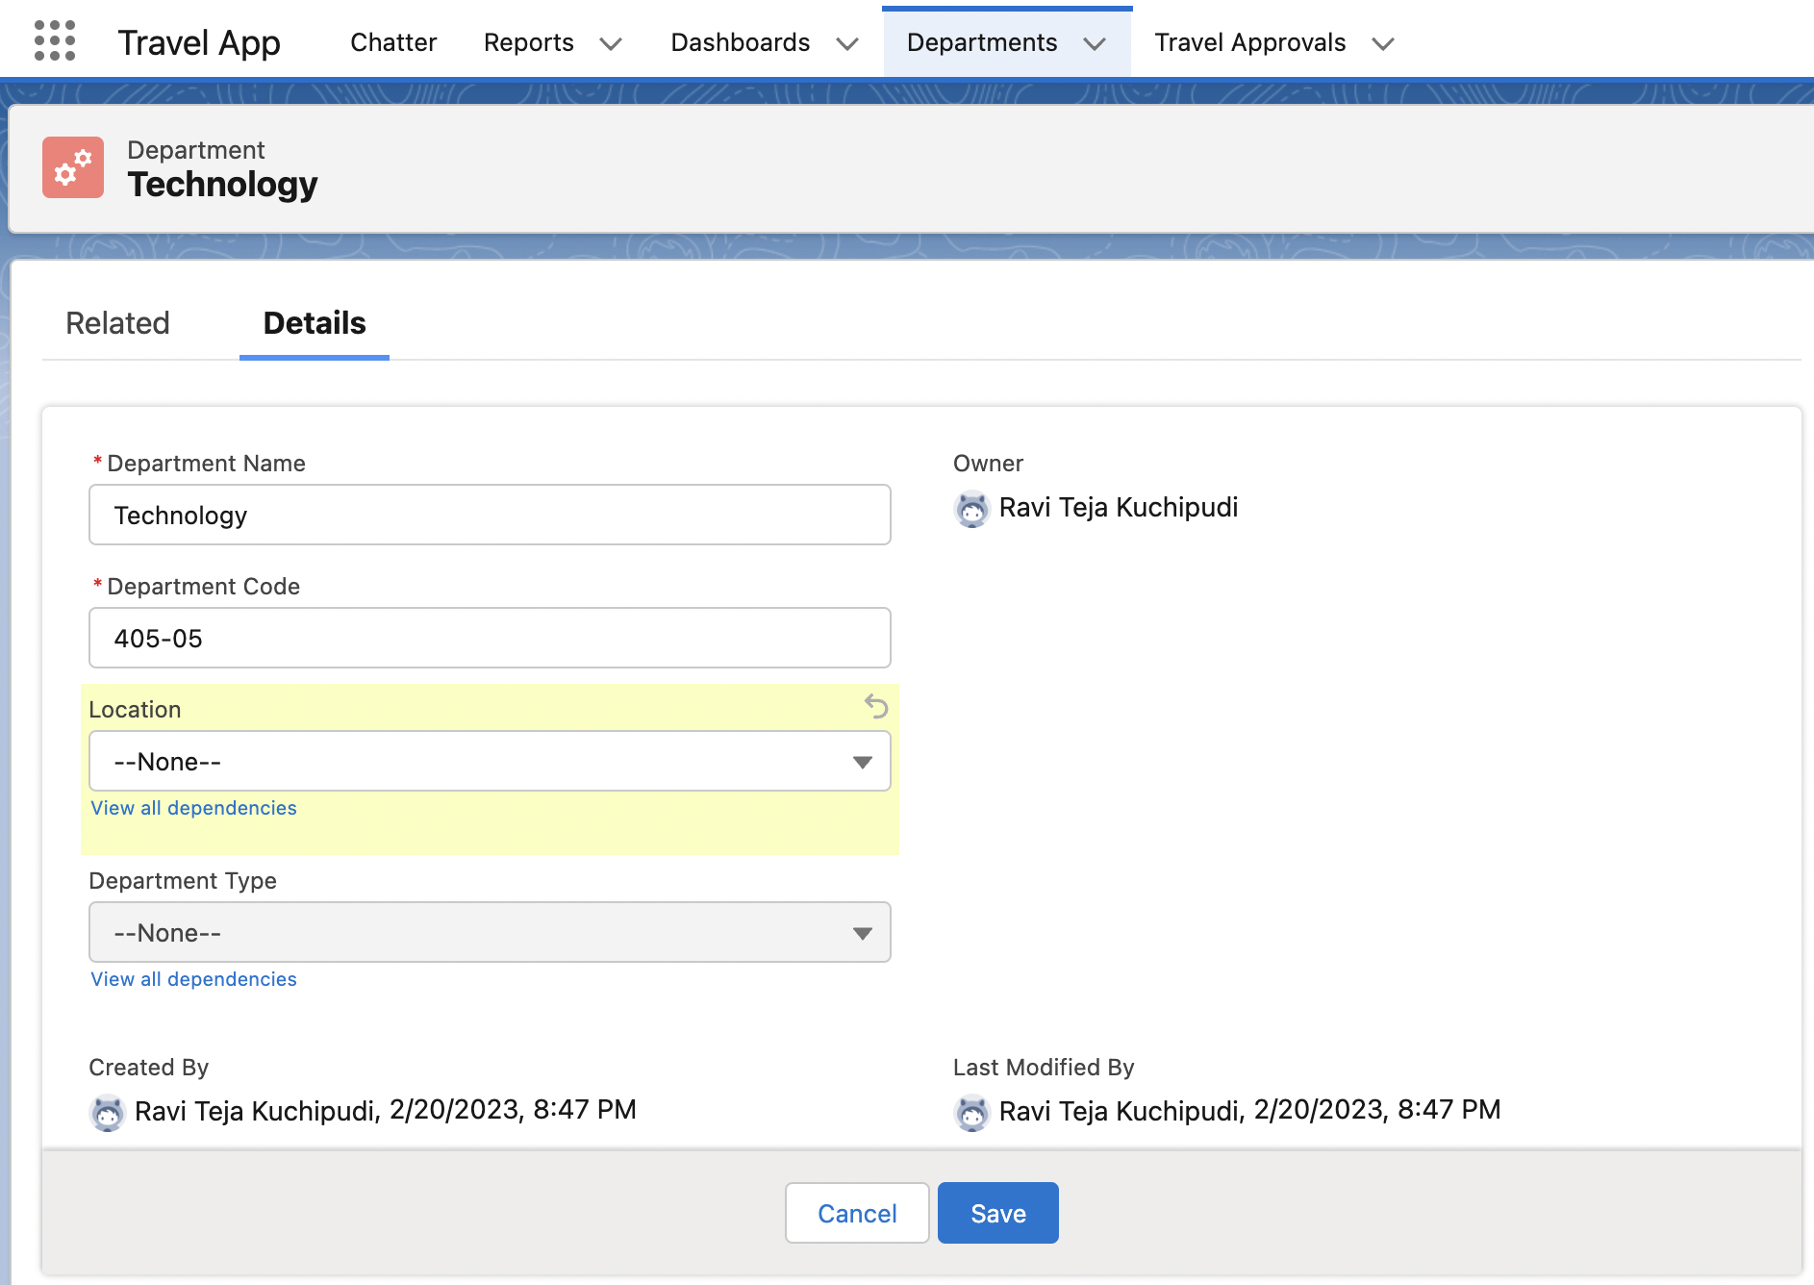
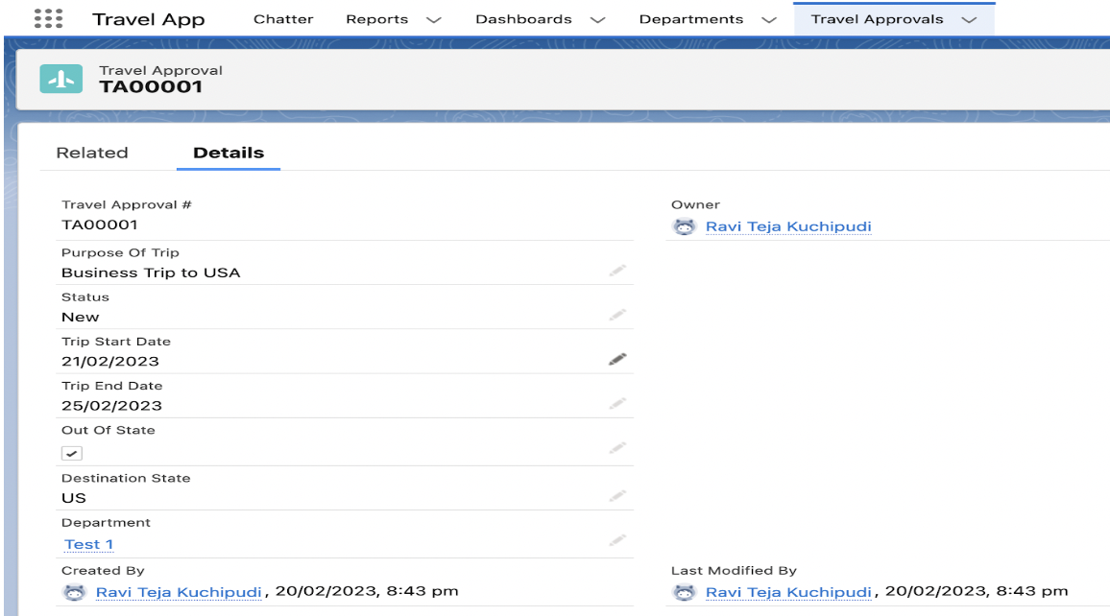
Create custom objects, fields and define relationship between objects.
The Custom Objects with names Department and Travel Approval and their respective fields and relationships are created.
←PickList
←Controlling field
←Dependent field
←Lookup with department sObject

Slide 6
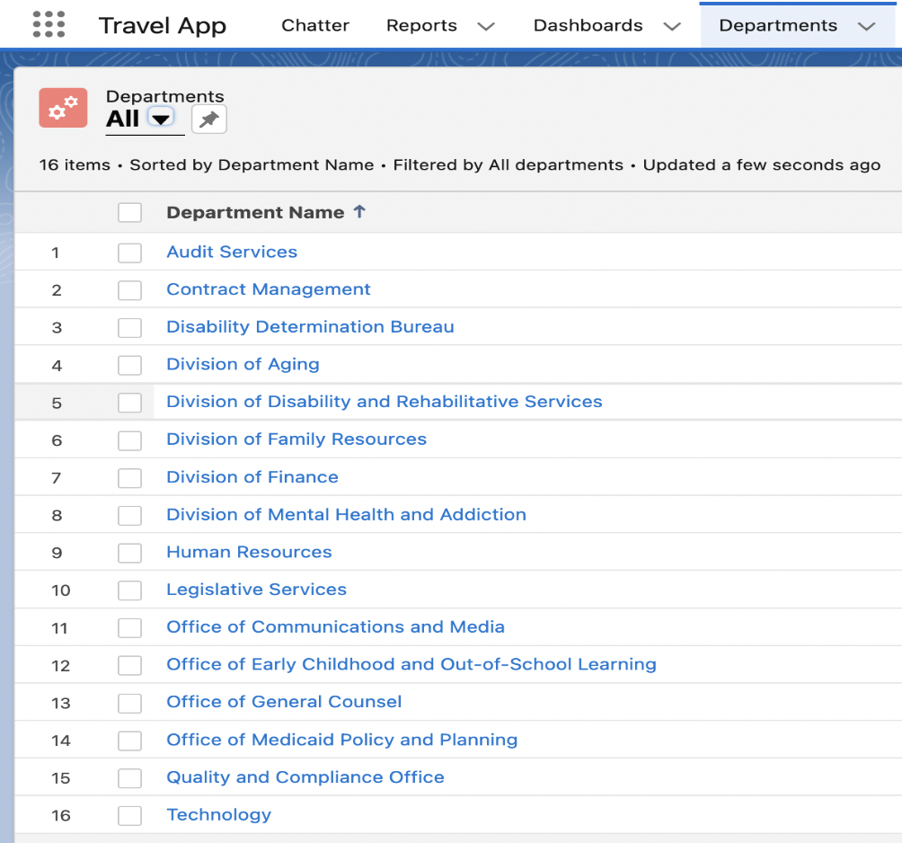
Import data
With the help of the tool Data Import Wizard. Department Data is imported from Department.csv
Data Import Wizard is the internal tool given
by Salesforce.
We can import 50 thousand records.
Here we can work only with 5 standard objects
and all custom objects

Slide 7
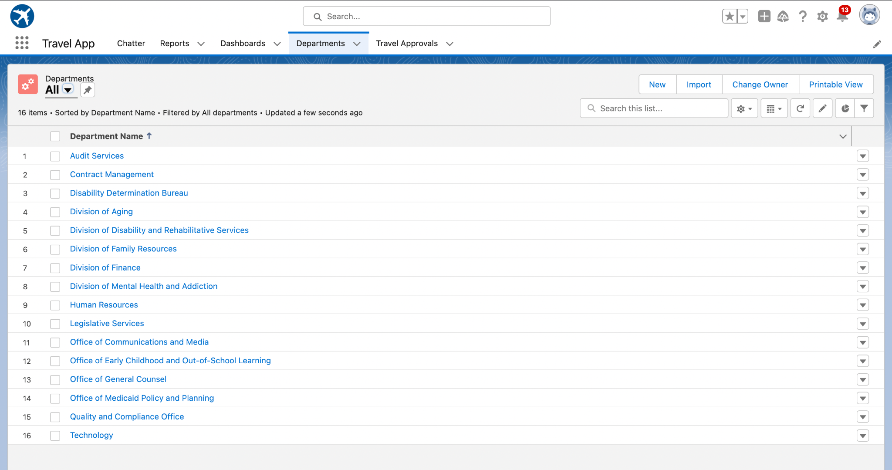
Test the App

Slide 8
Exercise - 2
Create Travel Approvals, Travel Expenses and users.
Customize List Views, page layouts and Related Lists.
Setup Approval setting for user.
Enable Chatter on travel approval object.

Slide 9
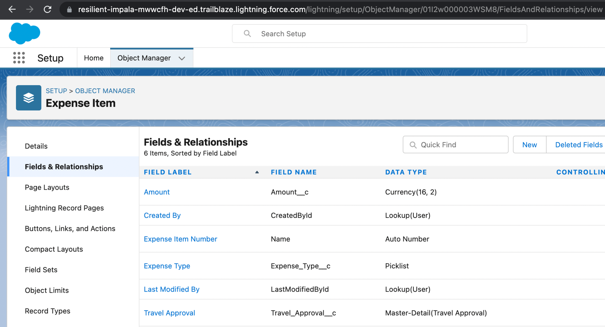
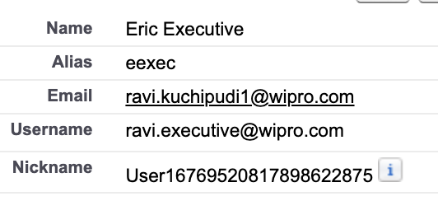
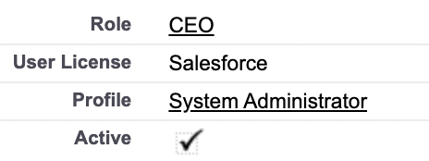
Create Travel Approvals, Travel Expenses and users.
A record is created in Travel Approvals.
An object with name Expense Item is created and tab is not created for this object.
User with name Eric Executive is created
←Master-Detail with Travel Approvals

Slide 10
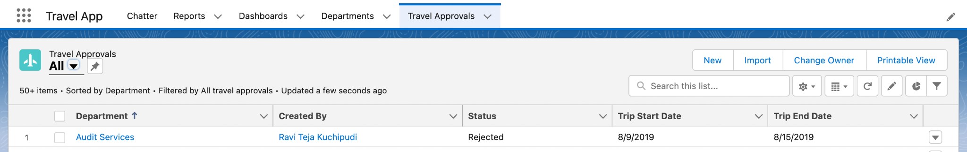
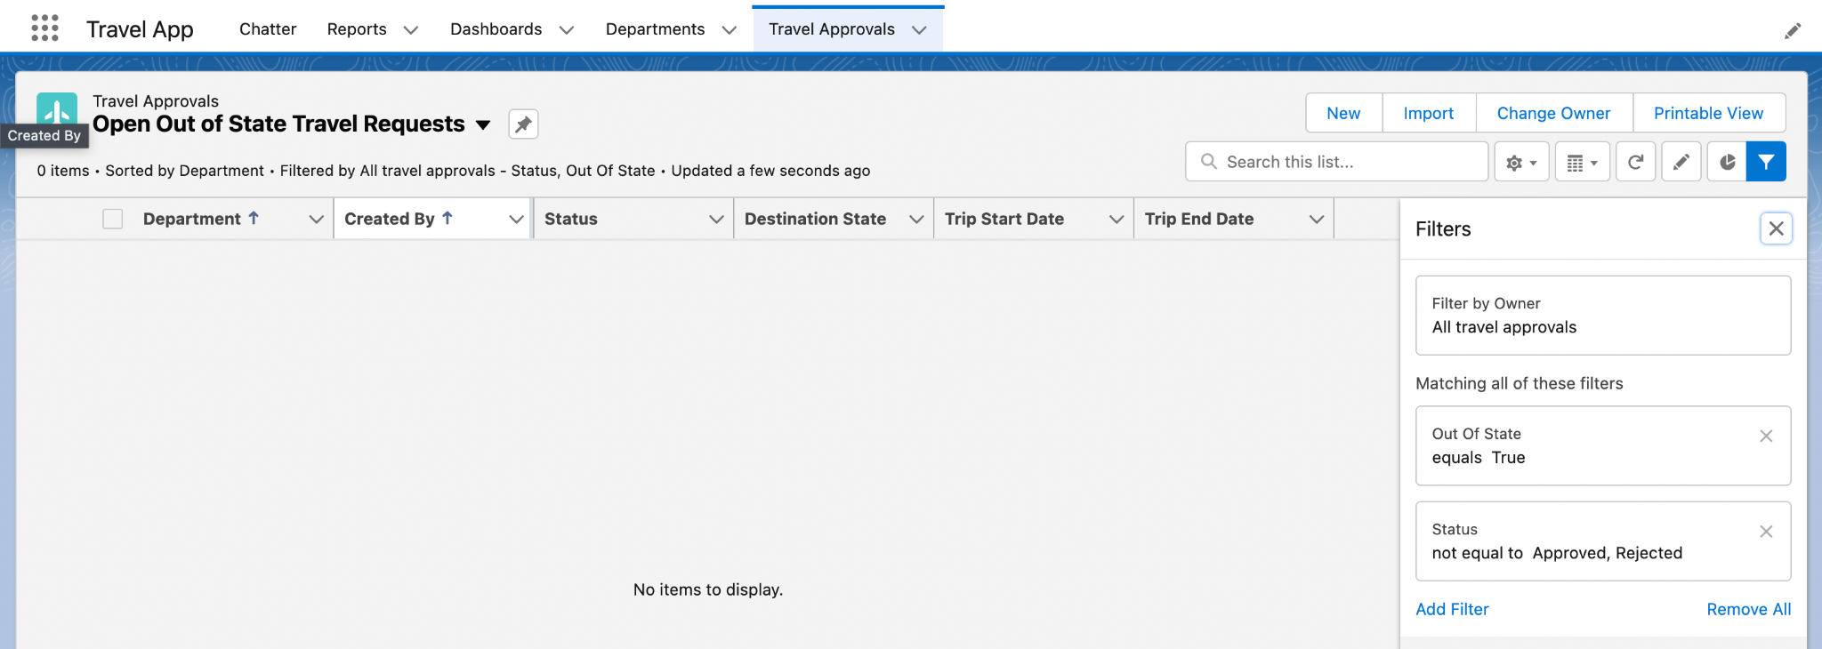
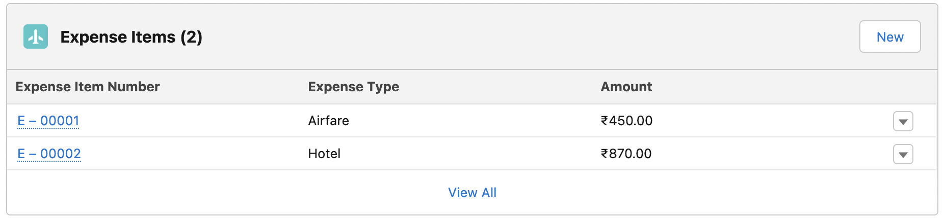
Customize List Views, page layouts and Relates Lists.
Customized “All” list View, “Open Out of State Travel Requests” list view and Related list view of Expense Item object in Travel Approval page.

Slide 11
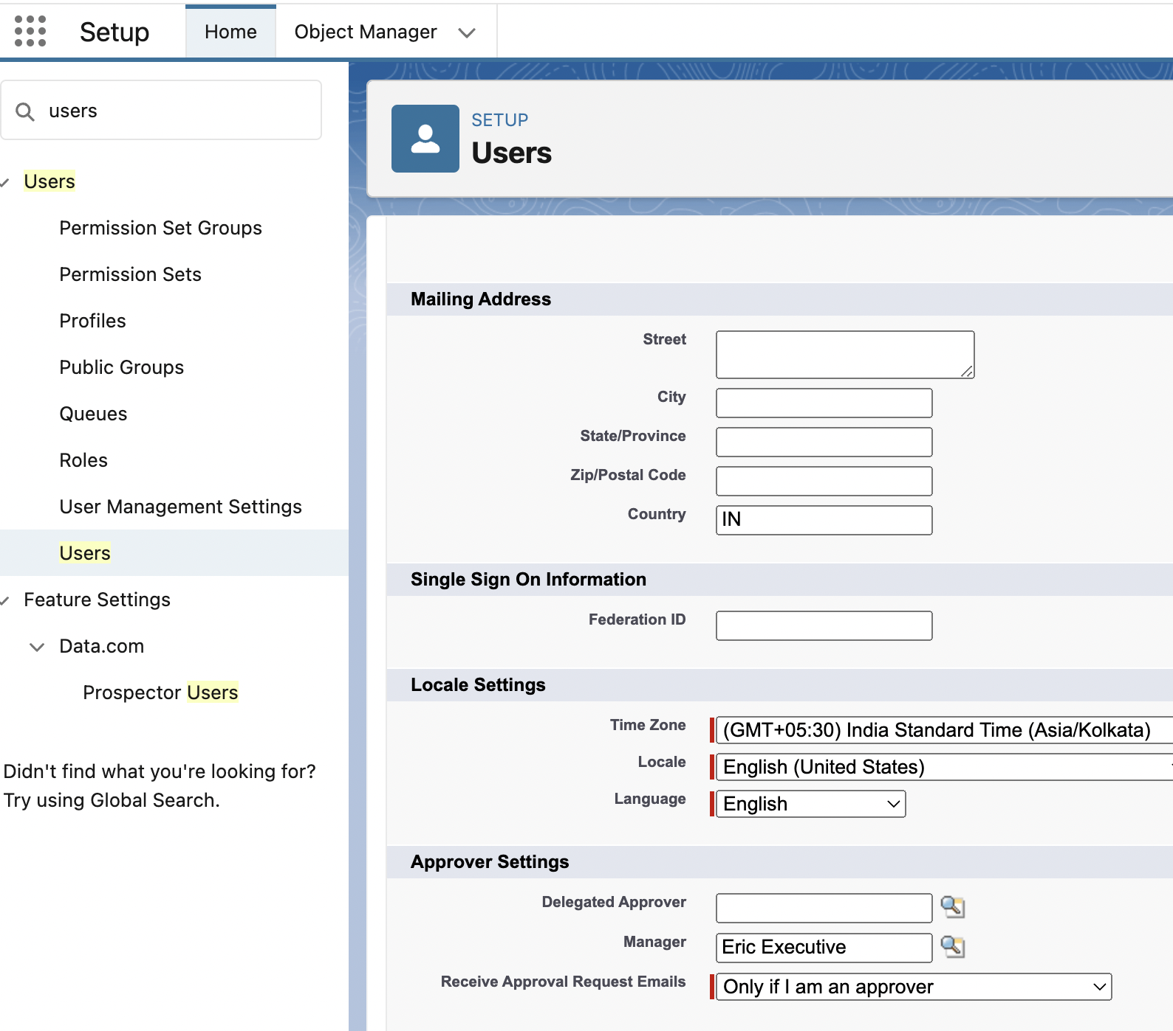
Setup Approval setting for user.
Added user Eric Executive as my manager

Slide 12
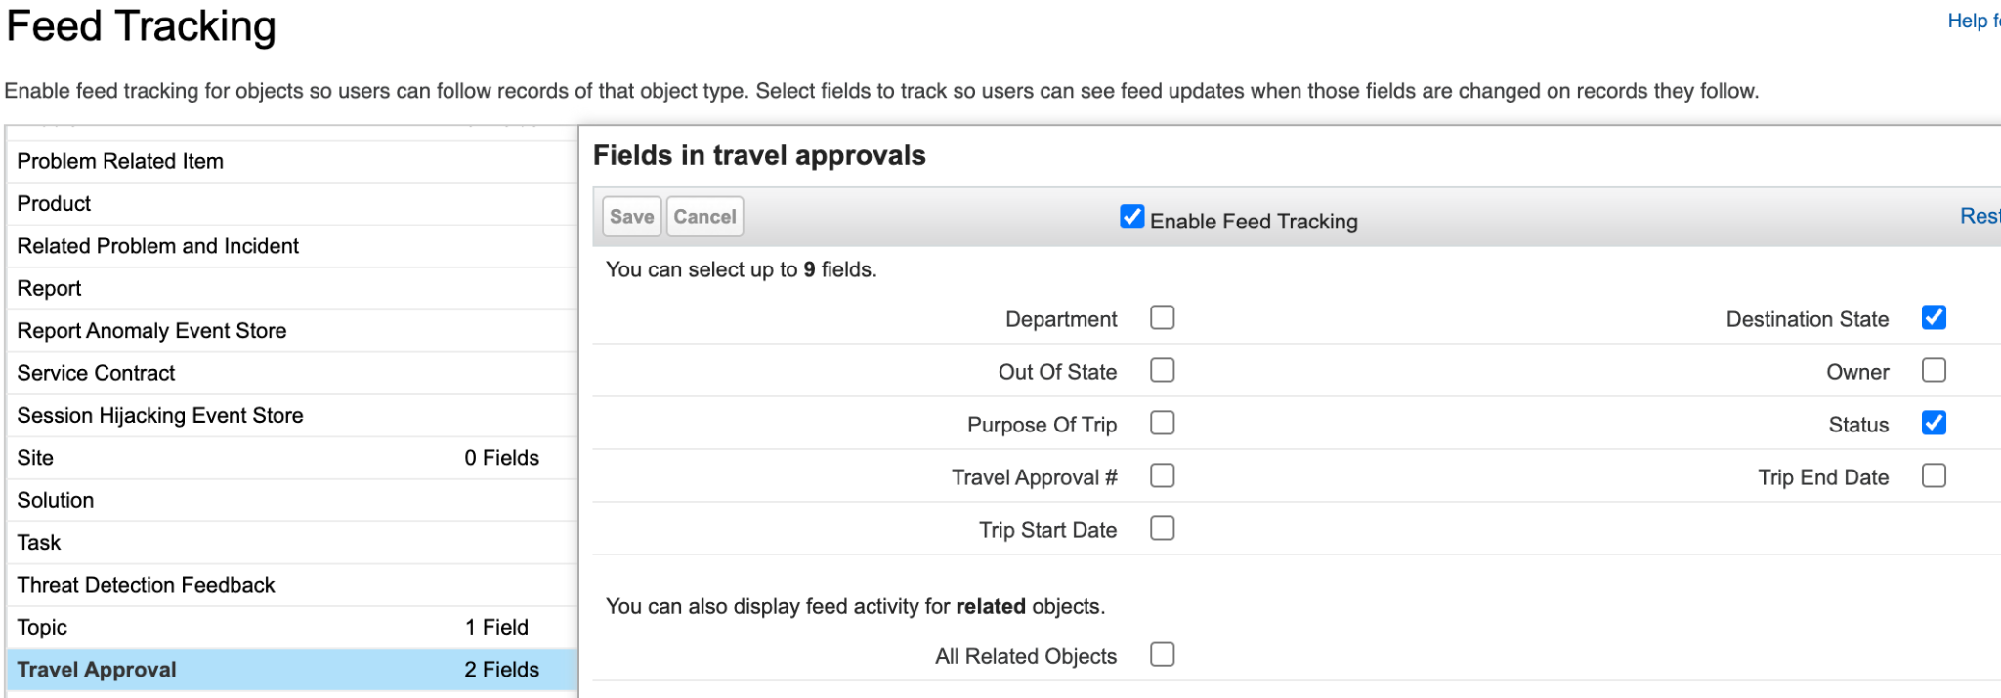
Enable Chatter on travel approval object.
Feed Tracking is Enabled on Destination State and Status Fields.
By doing this users can see feed updates when those fields are changed on the records they follow.

Slide 13
Module - 2

Slide 14
Exercise - 1
Create Validation Rules
Setup Roll-up summary & Formula field
Configure Flows.
Configure Approval Process.
Test the app.

Slide 15
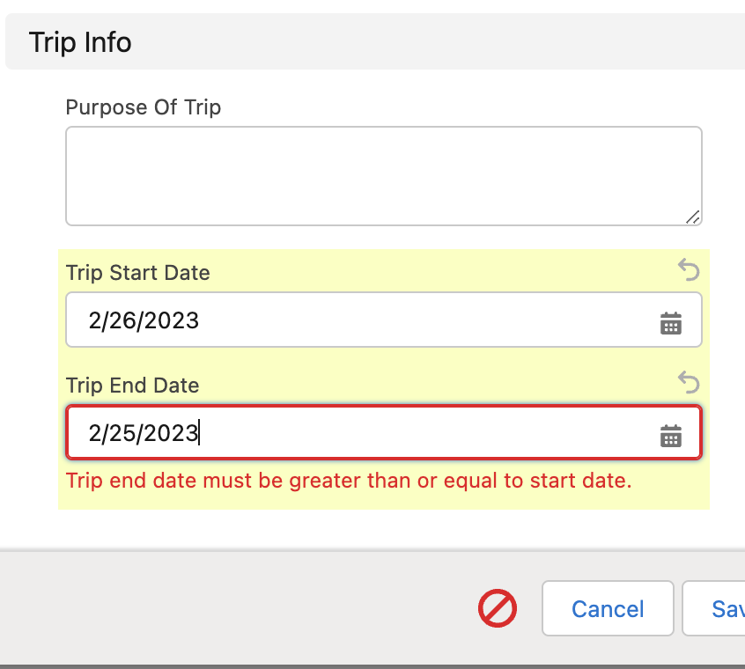
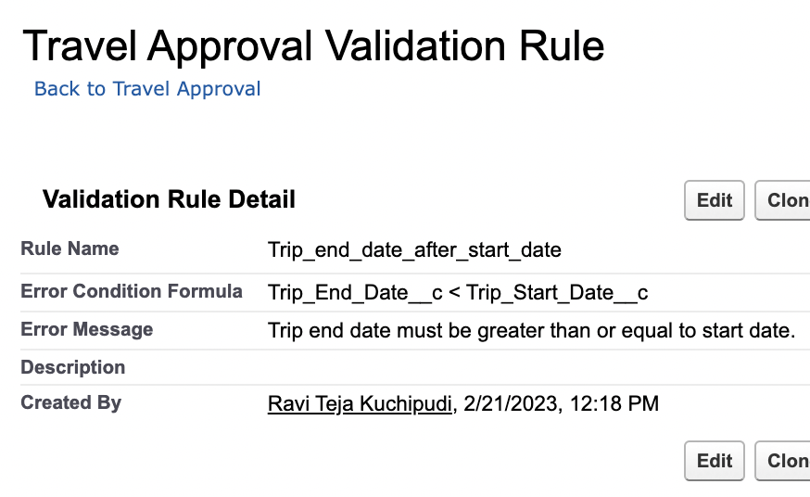
Create Validation Rules
Business Logic: Trip end date must always be greater than (>=) the trip start date.
Validation rule will be fired when condition becomes true.

Slide 16
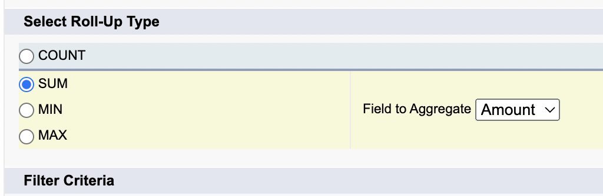
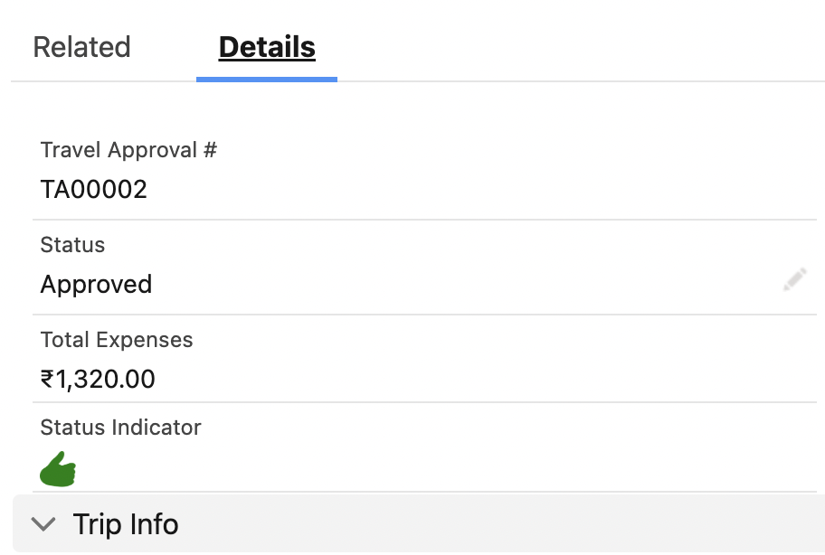
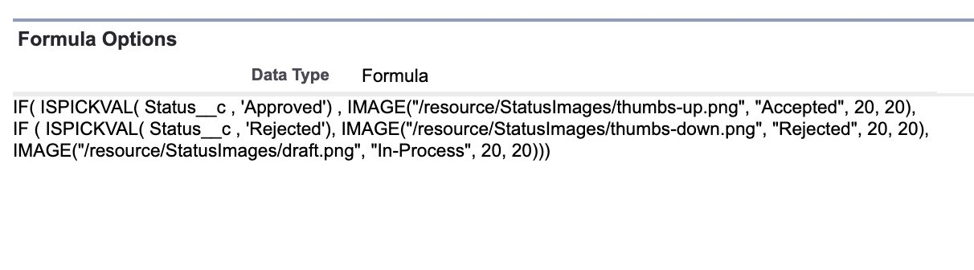
Setup Roll-up summary & Formula field
Roll-up summary: Automatically sum up the total amount of expenses from the related Expense Item.
Formula field: Created a field that shows a visual indicator based on the value of the Status field
← Roll-up summary
← Formula field

Slide 17
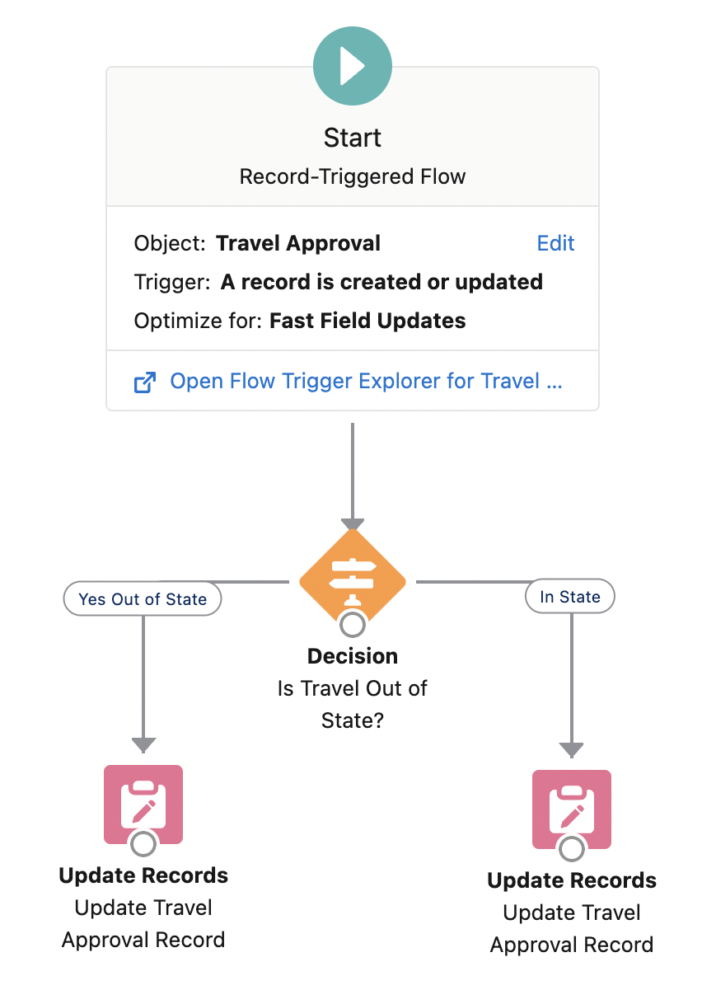
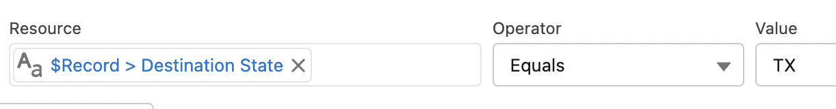
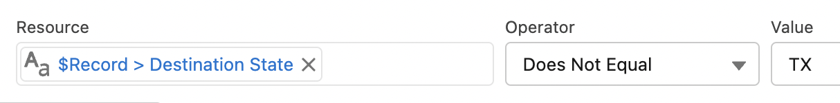
Configure Flows.
Created a Record – Triggered Flow on Travel Approval object.
Whenever the record is created or updated.
If Destination State is TX then it is - in State.
If Destination Sate is no equal ro TX then it is - Out of state (in this case Checkbox should be checked).

Slide 18
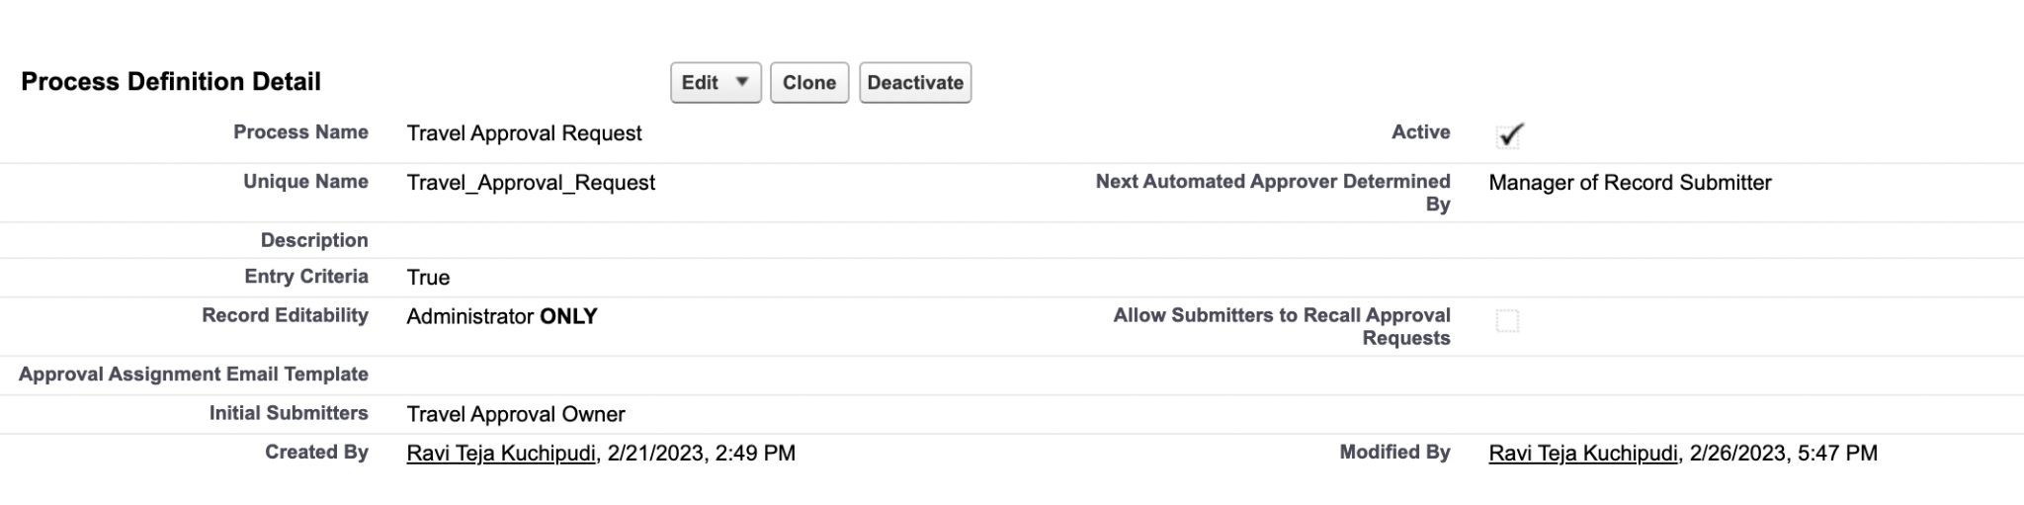
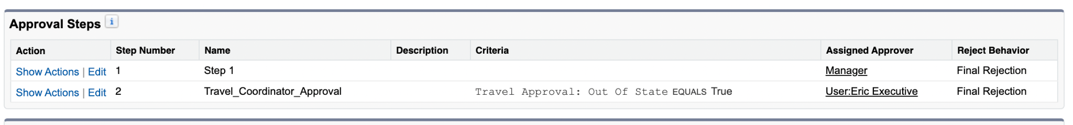
Approval Process.
Created an Approval Process to send Travel approvals to Manager or Travel coordinator.
Created Approval Steps:
If Out Of State = True then further Travel coordinator (Eric Executive) approval is also required.

Slide 19
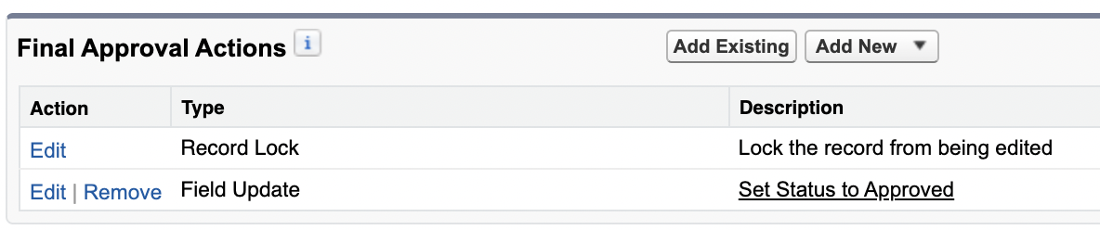
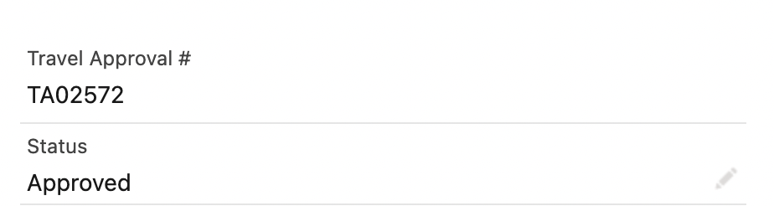
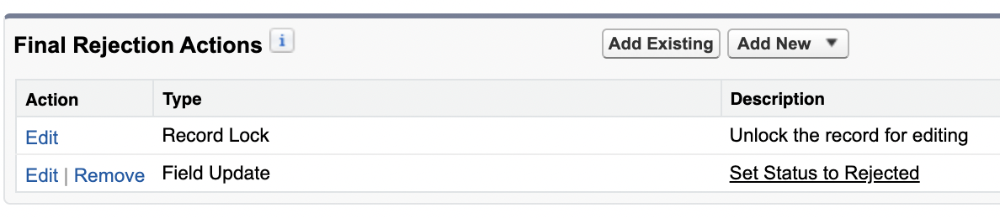
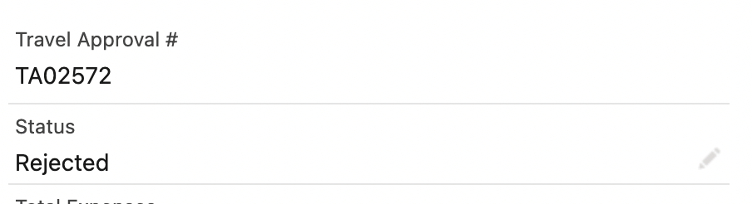
Continued...
Created final Approval Actions: when Approved, then Status Field will Updated to Approved.
Created final Rejection Actions: when Rejected, then Status Field will Updated to Rejected.

Slide 20
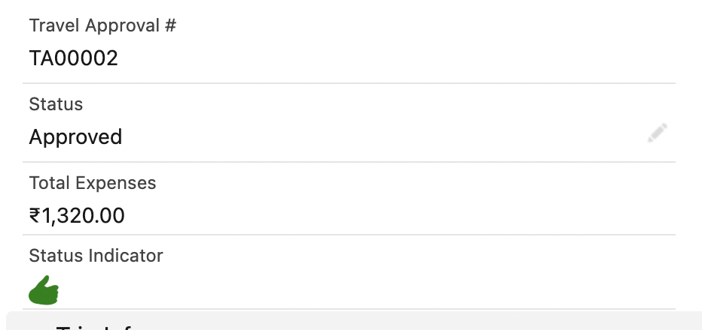
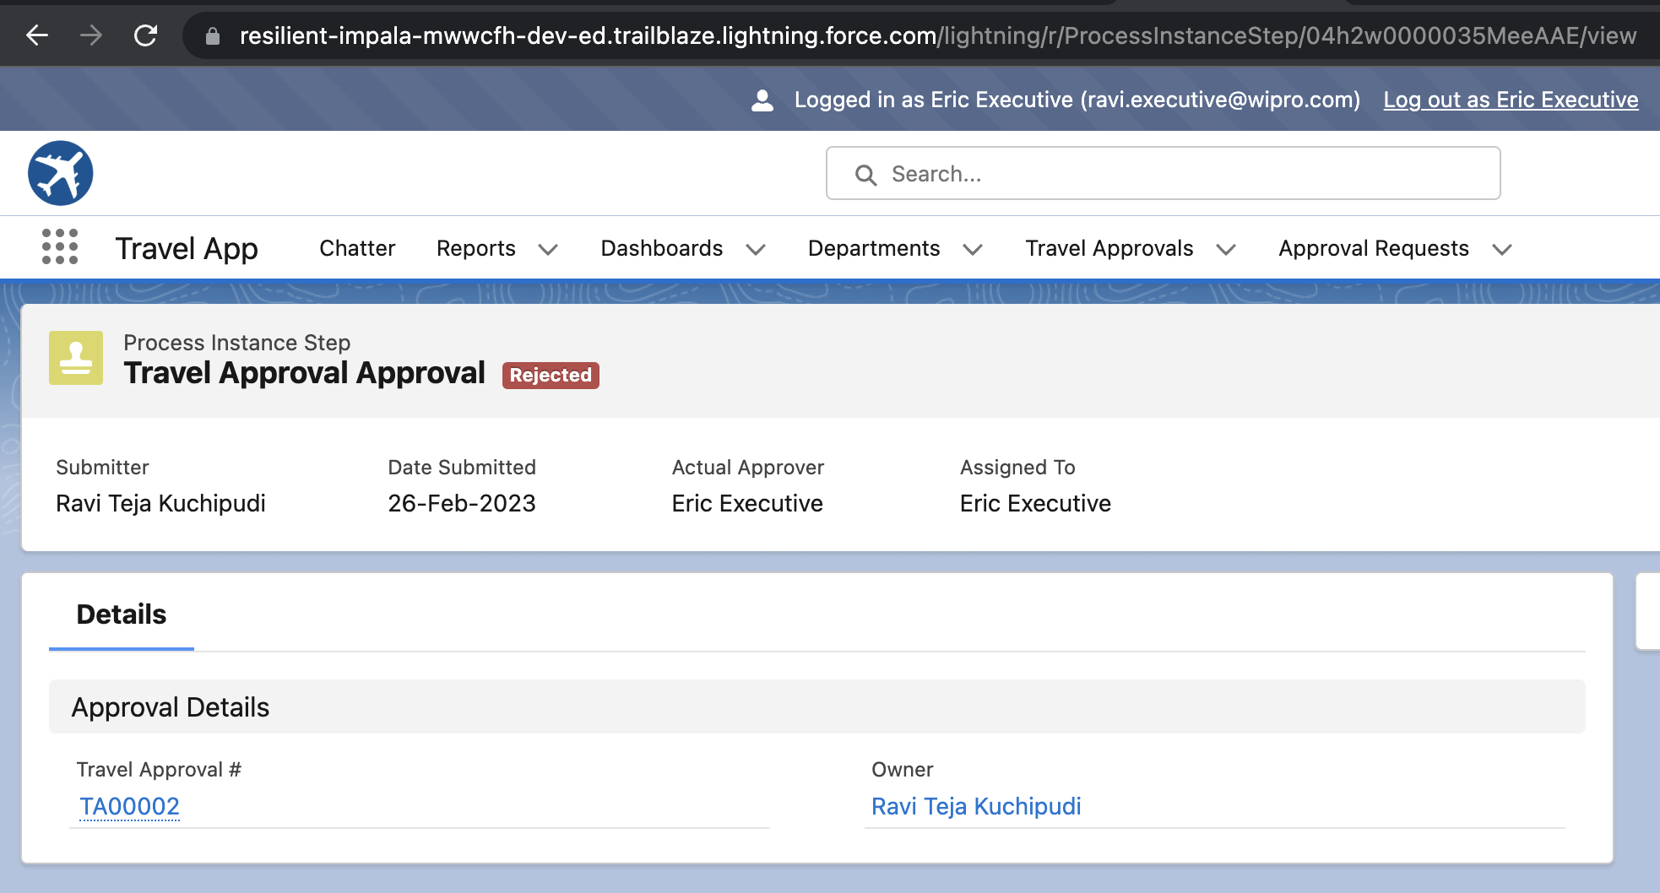
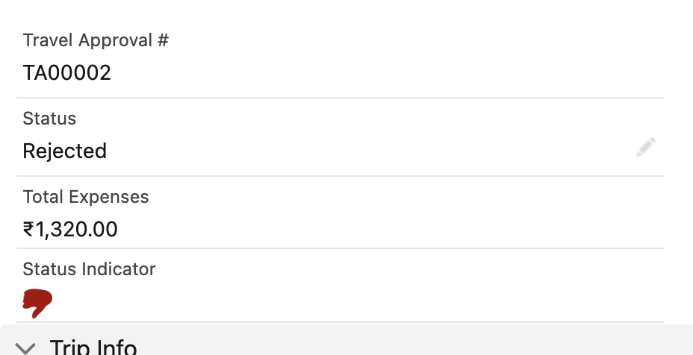
Test the app.

Slide 21
Exercise - 2
Create Travel Request by Department Report.
Create Travel Request by Month
Create Travel Approval Dashboard

Slide 22
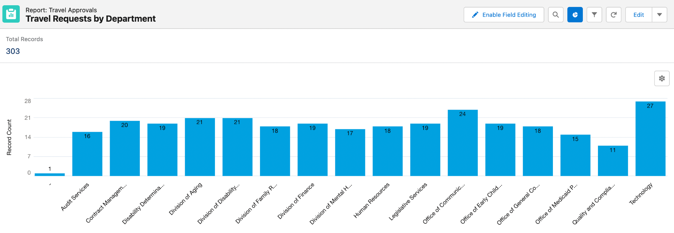
Create Travel Request by Department Report.
Rows are grouped by Department and then grouped by Status

Slide 23
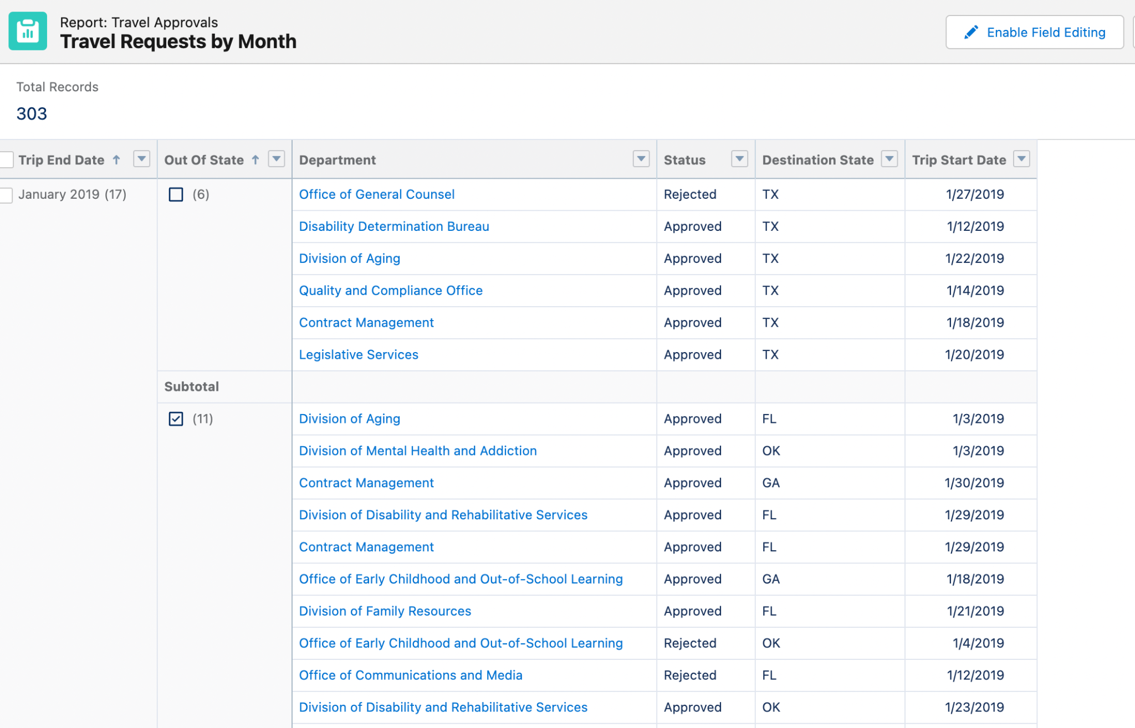
Create Travel Request by Month
Rows are grouped by Trip End Date (Dates are grouped by Calendar month) and then Out-Of-State.

Slide 24
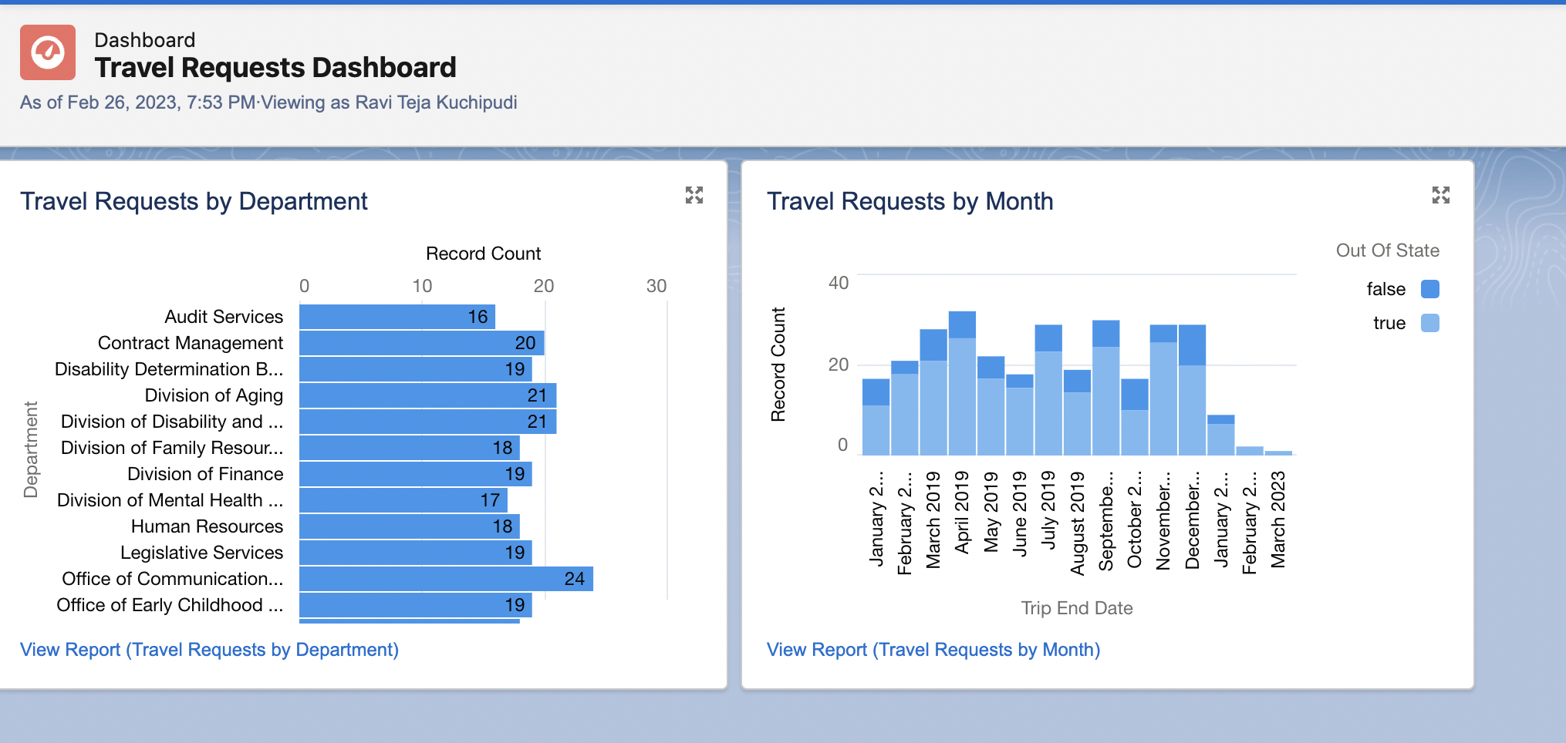
Create Travel Approval Dashboard
Horizontal bar Chart Stacked Vertical Bar Chart

Slide 25
Module - 3

Slide 26
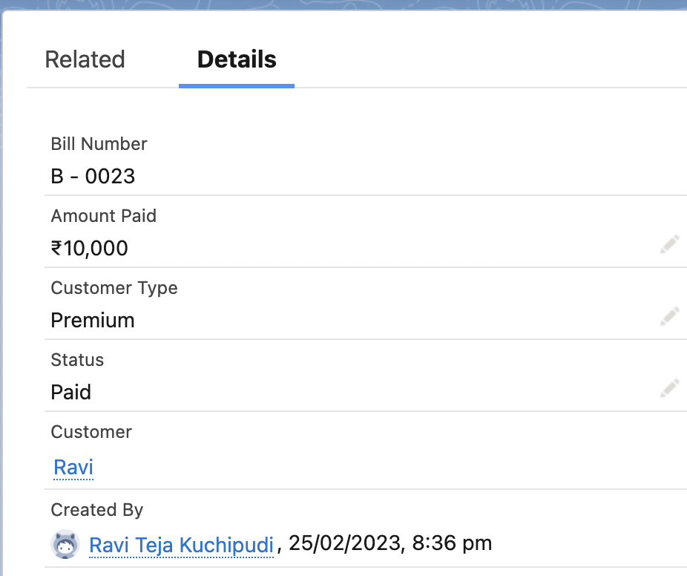
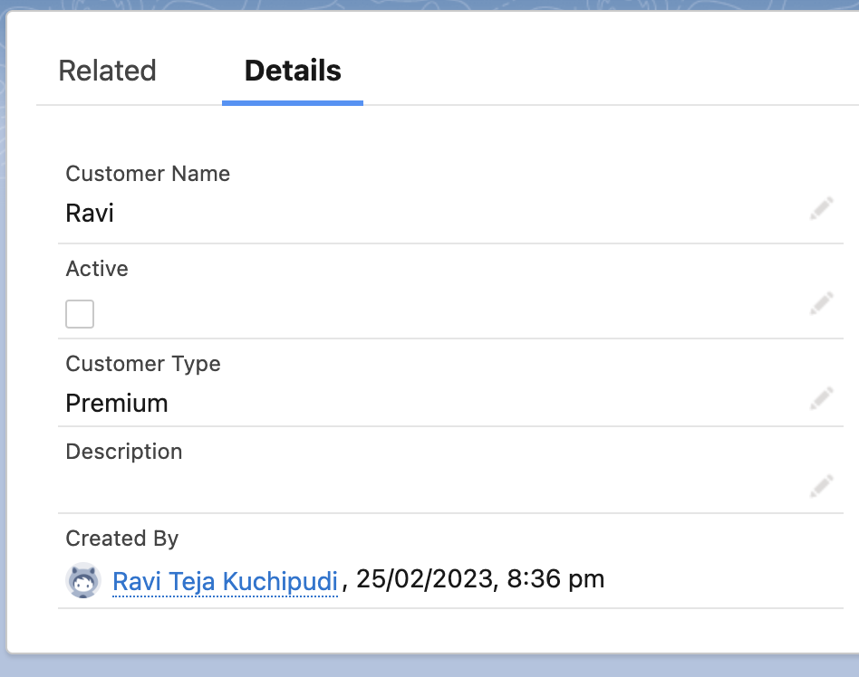
Exercise - 1
A custom App with name Code Playground is created. Customer and Billing custom objects are created.
Billing Record Customer Record
← Master -Detail Relationship with Customer

Slide 27
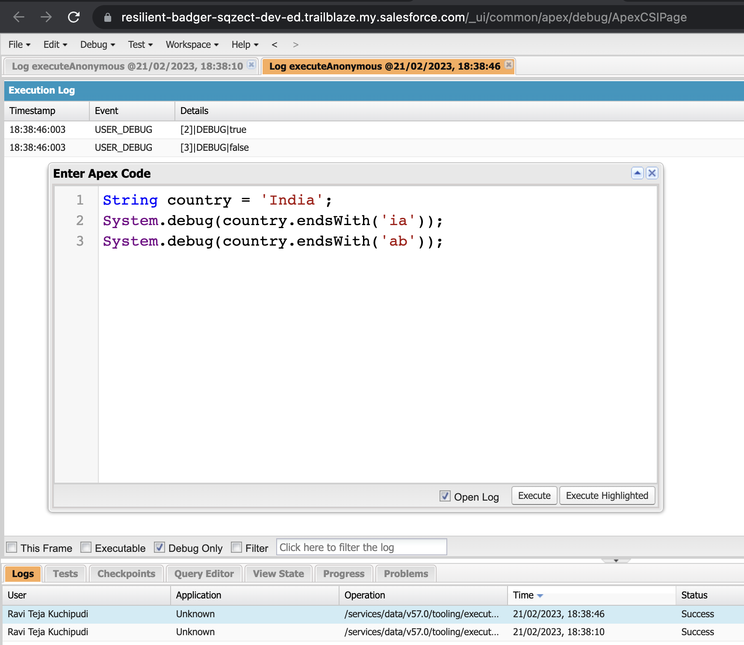
Exercise - 2
Use Execute Anonymous to define and execute the following code:
Define a String Variable & use string method ‘endsWith’ to display the output.

Slide 28
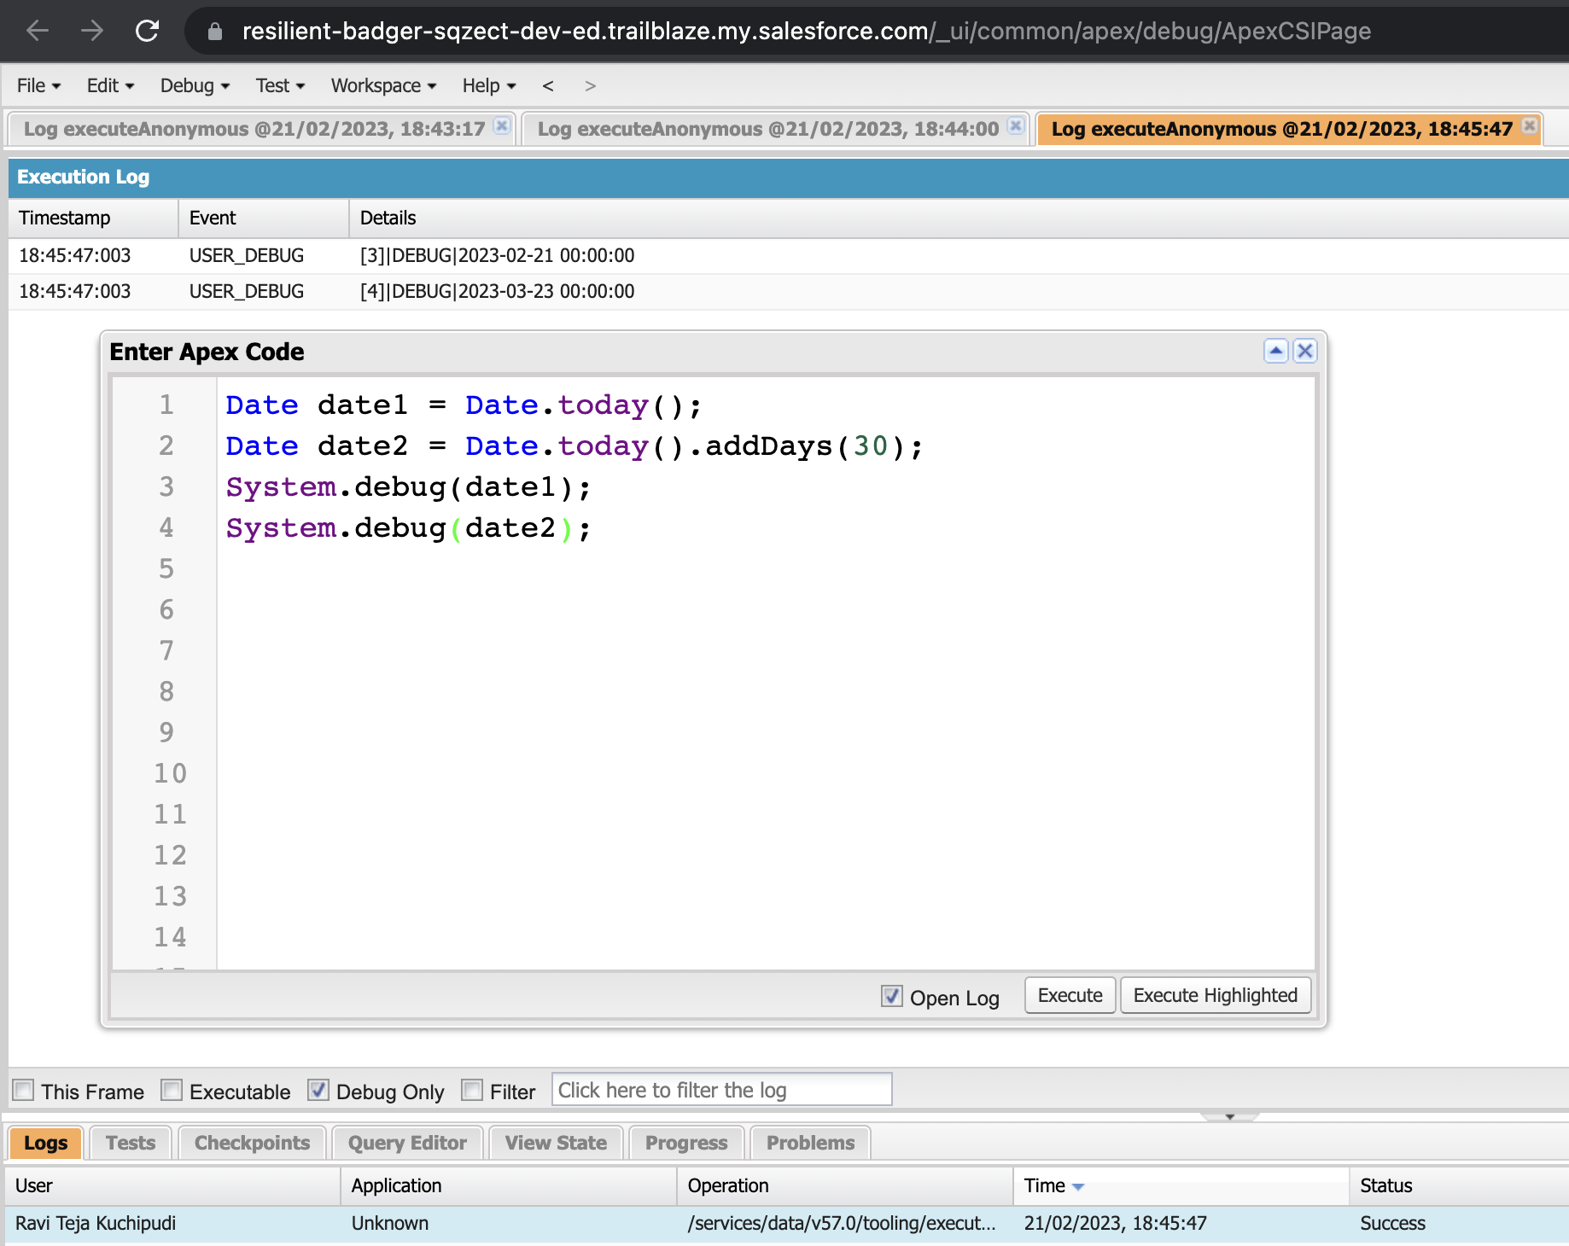
Exercise - 2
Use Execute Anonymous to define and execute the following code:
Define 2 Date type variables, use Date method today() & addDays(30) to display the output.

Slide 29
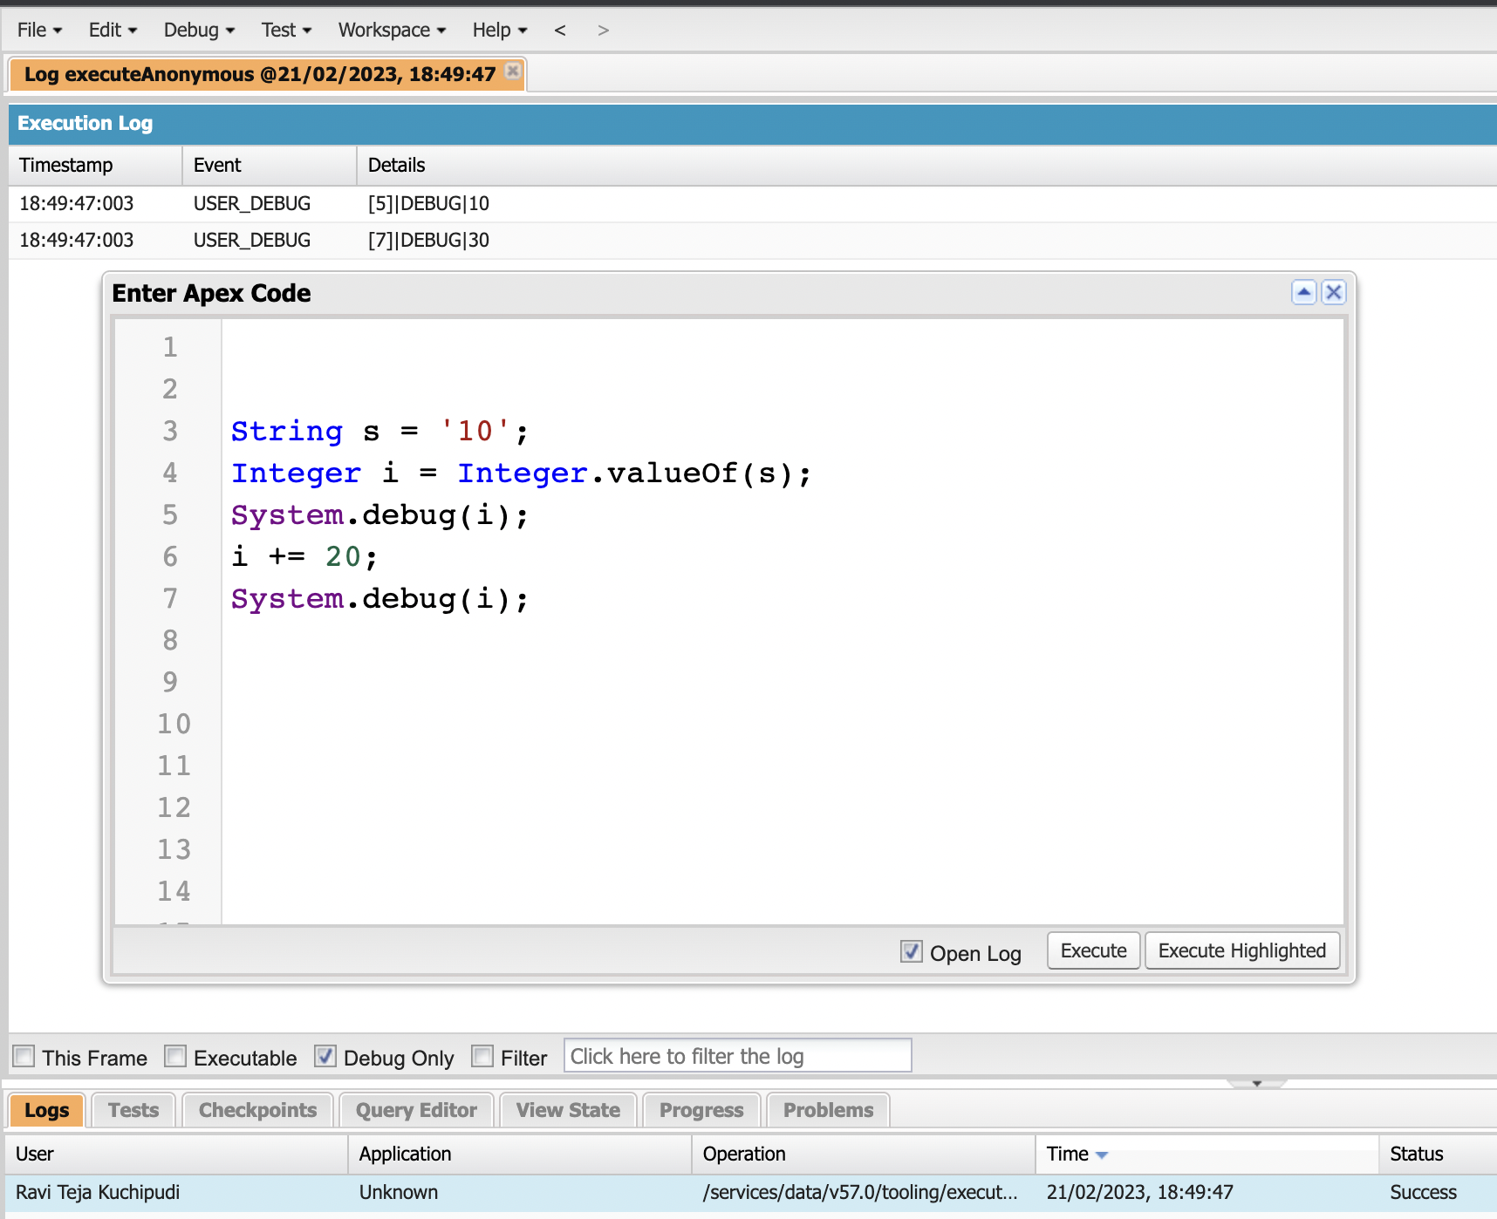
Exercise - 2
Use Execute Anonymous to define and execute the following code:
Display the output of an Integer variable from string ‘10’ and add 20 to it.

Slide 30
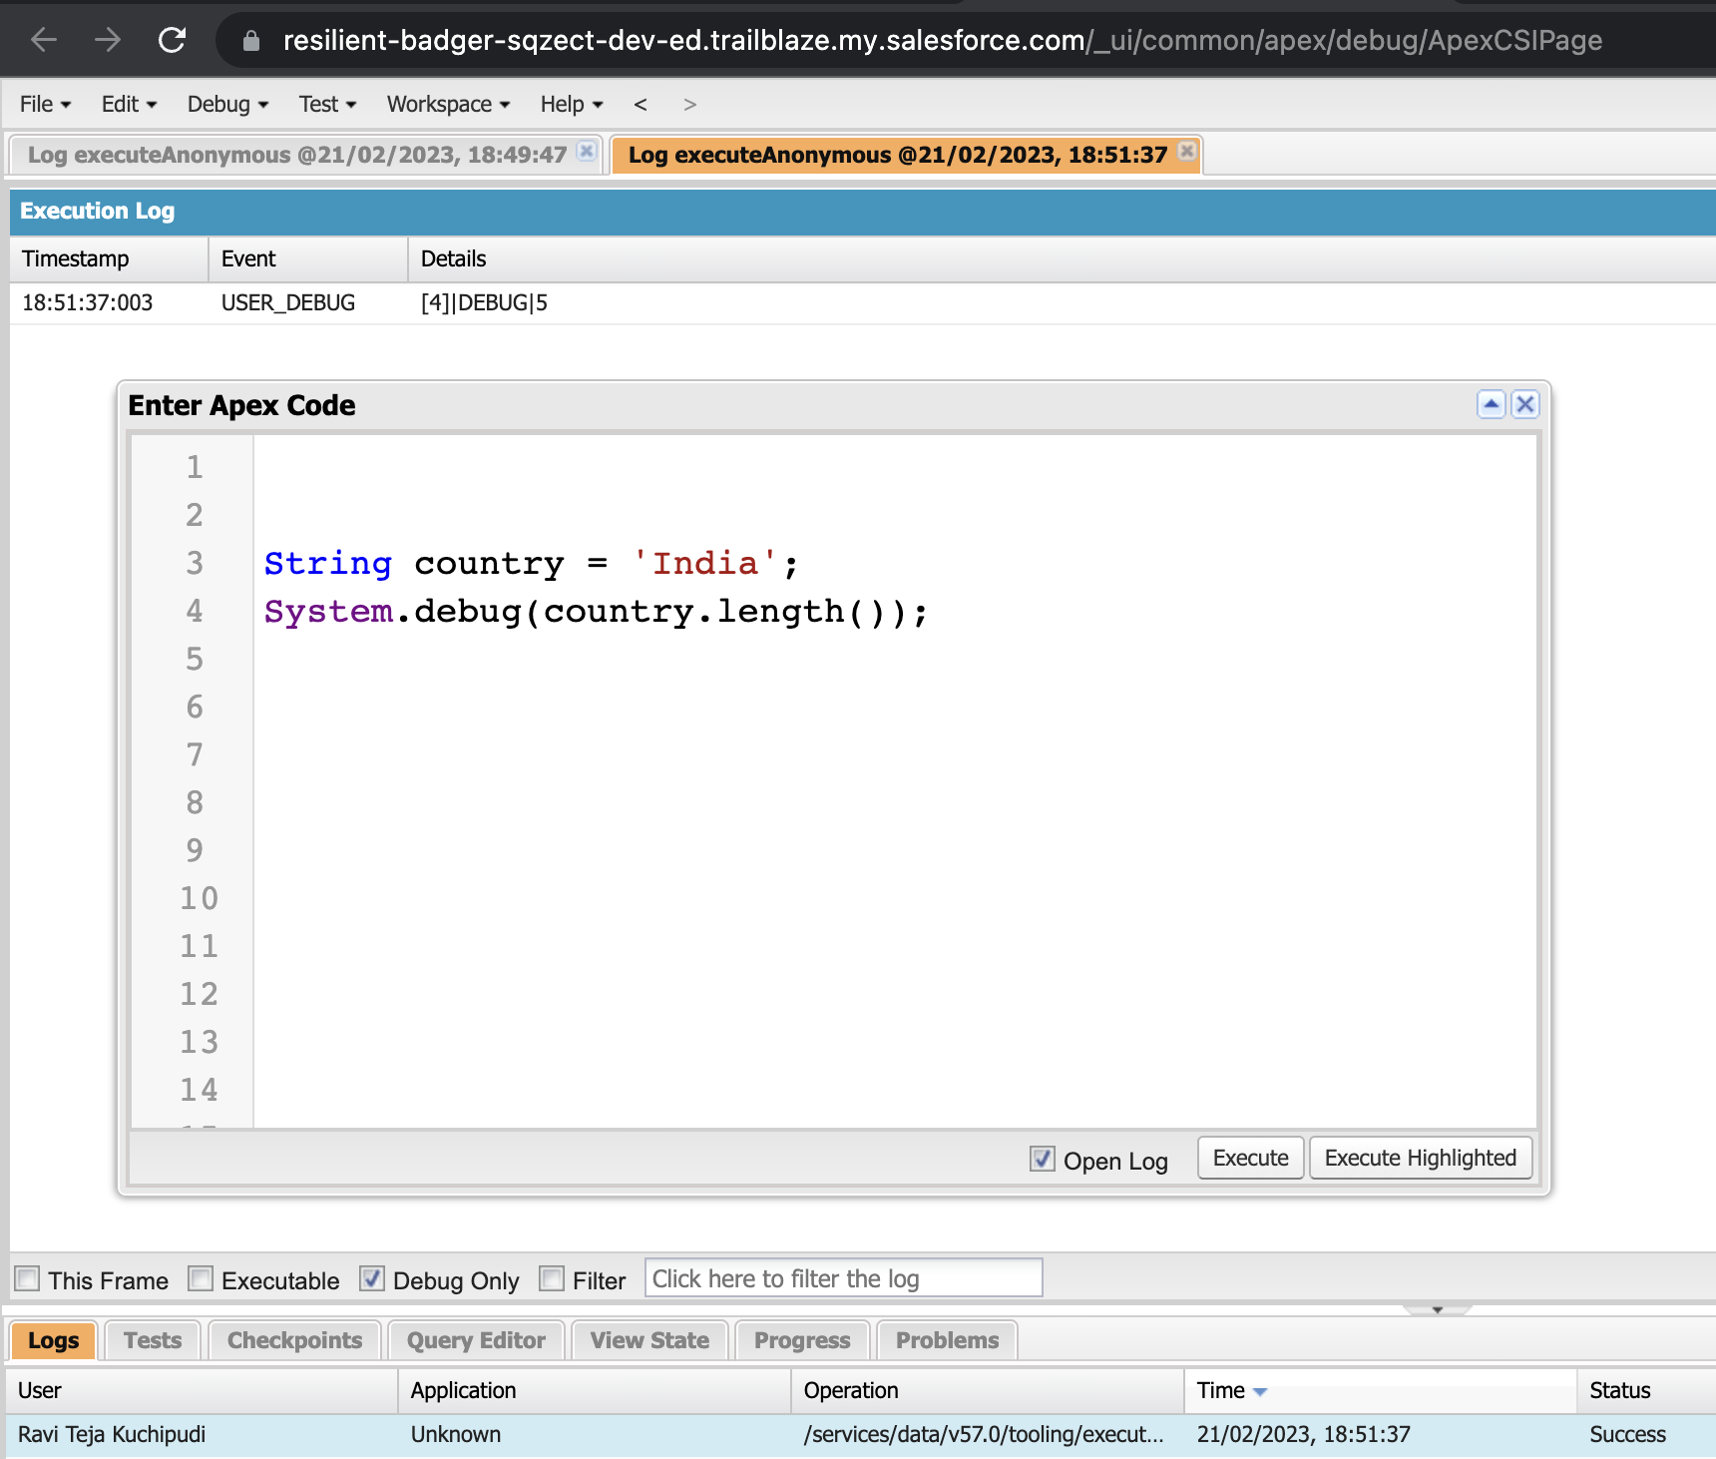
Exercise - 2
Use Execute Anonymous to define and execute the following code:
Define a String Variable & use string method length() to display the output.

Slide 31
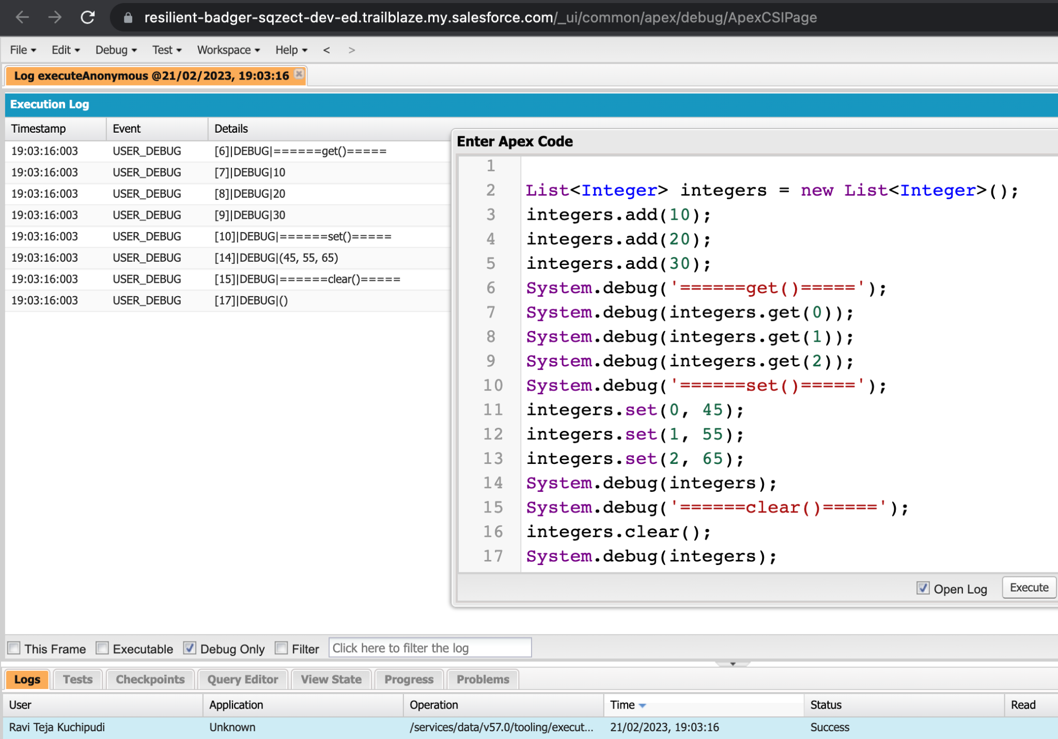
Exercise - 2
Use Execute Anonymous to define and execute the following code:
Define a List of integer and display the output using add(), get(), set(), clear(), methods

Slide 32
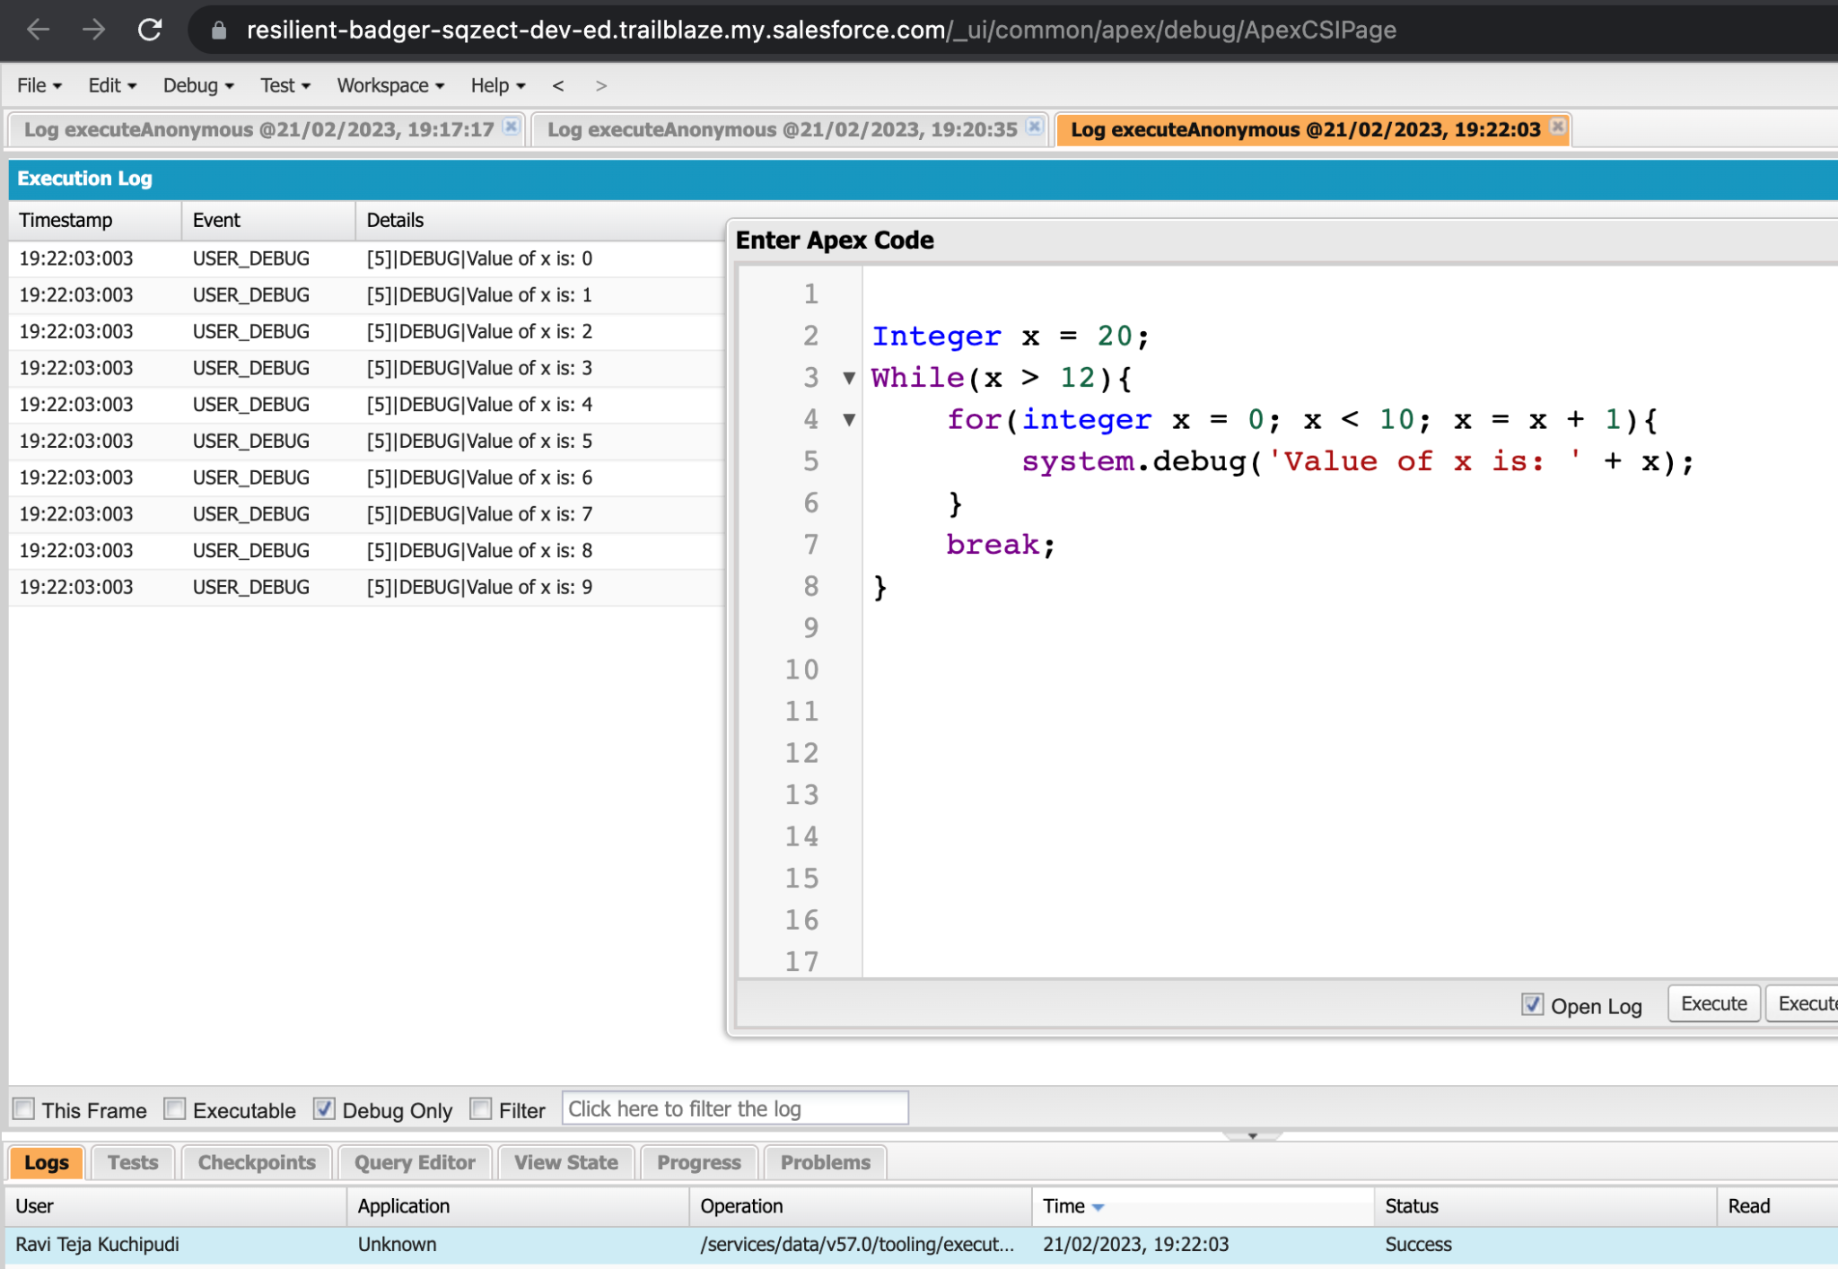
Exercise - 2
Use Execute Anonymous to define and execute the following code:
Use Execute Anonymous to define and execute the following code to display the value of x = 0 to 9.

Slide 33
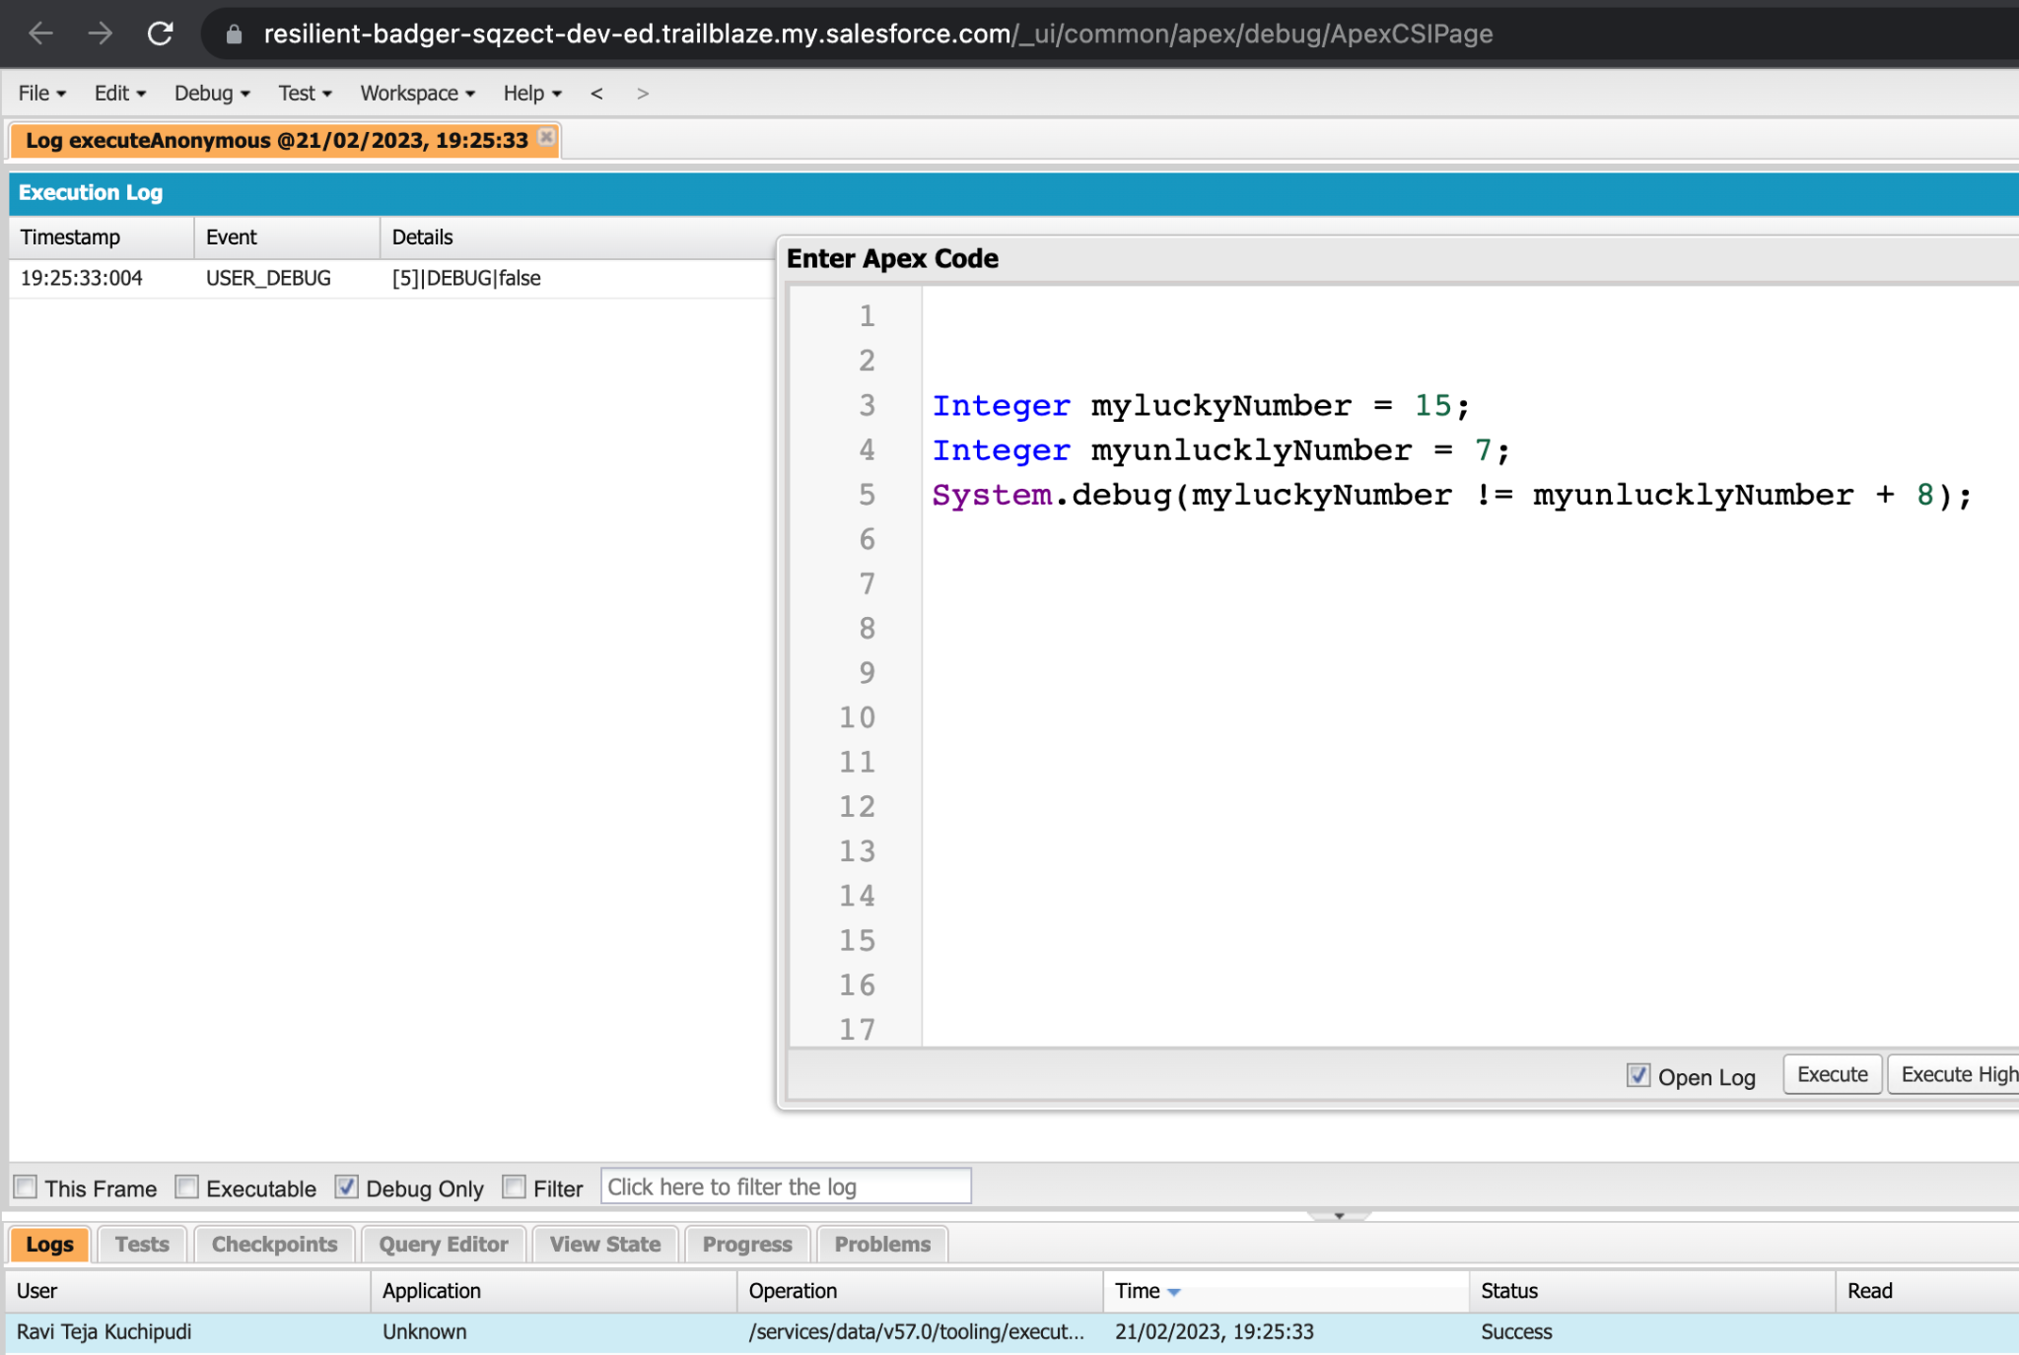
Exercise - 3
Answer the following in True Or False: (False)
Integer myluckyNumber = 15;
Integer myunlucklyNumber = 7;
myluckyNumber != myunlucklyNumber + 8.

Slide 34
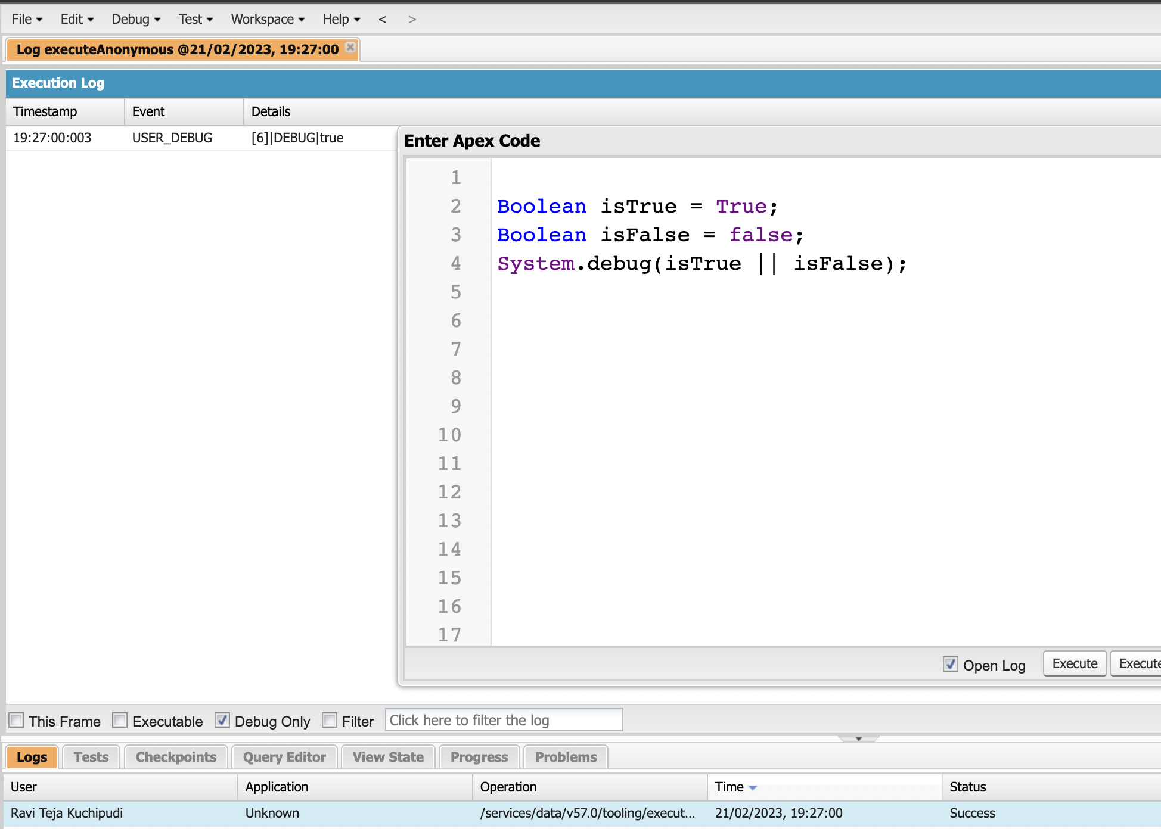
Exercise - 4
Answer the following in True Or False: (True)
Boolean isTrue = True;
Boolean isFalse = false;
isTrue || isFalse

Slide 35
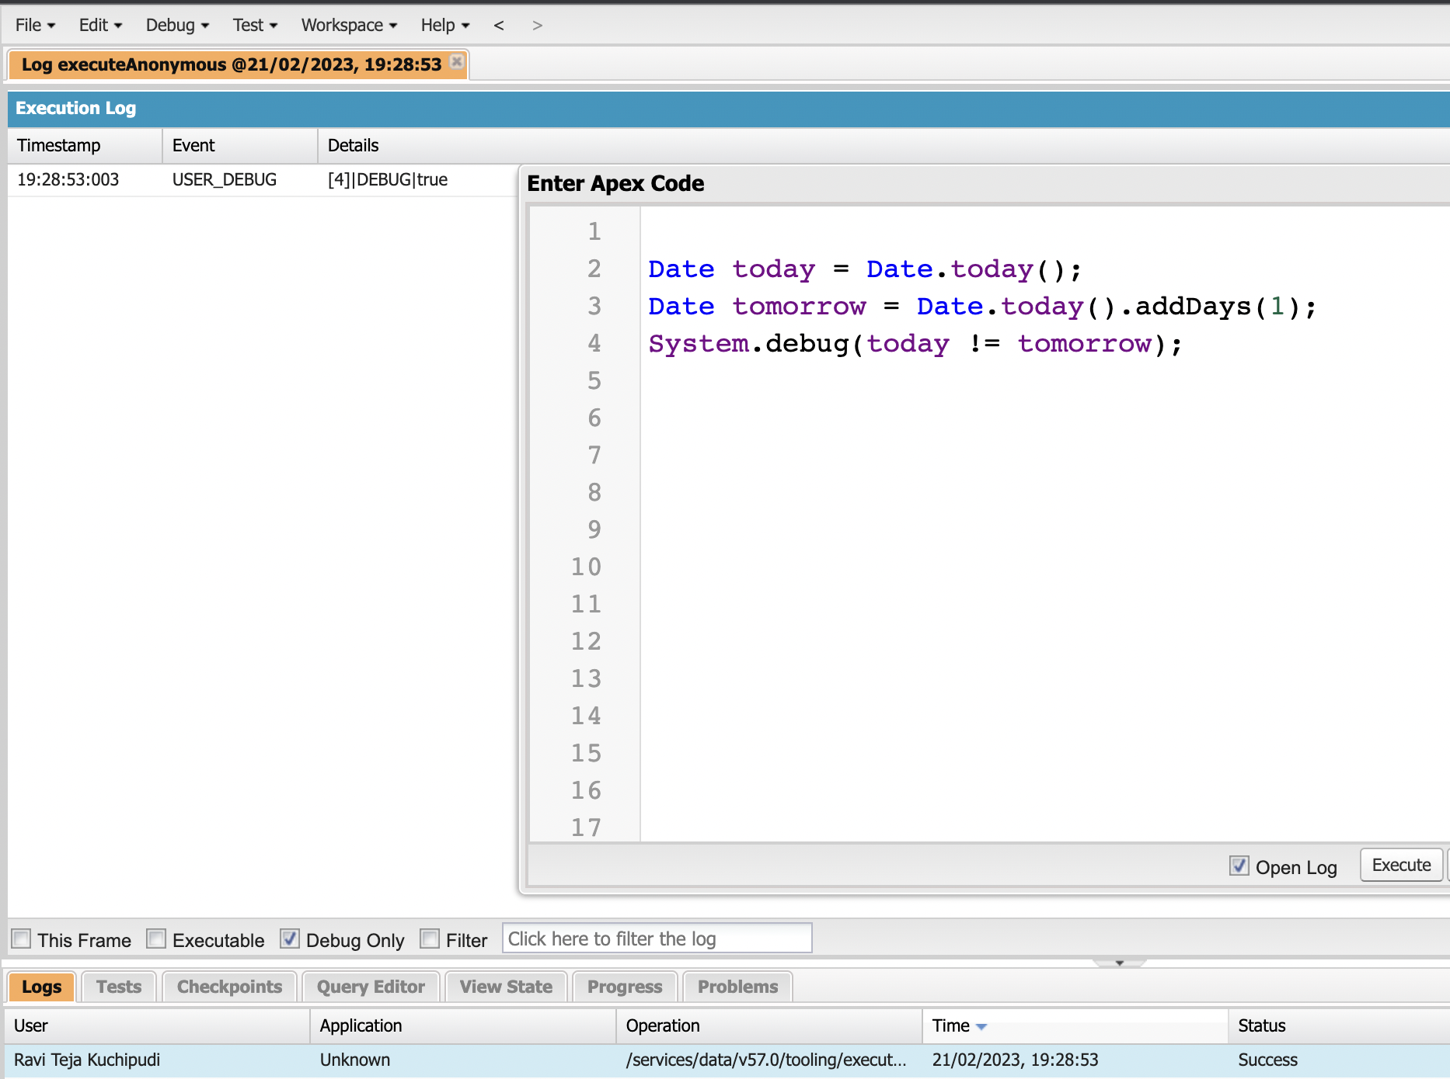
Exercise - 5
Answer the following in True Or False: (True)
Date today = Date.today();
Date tomorrow = Date.today().addDays(1);
today != tomorrow

Slide 36
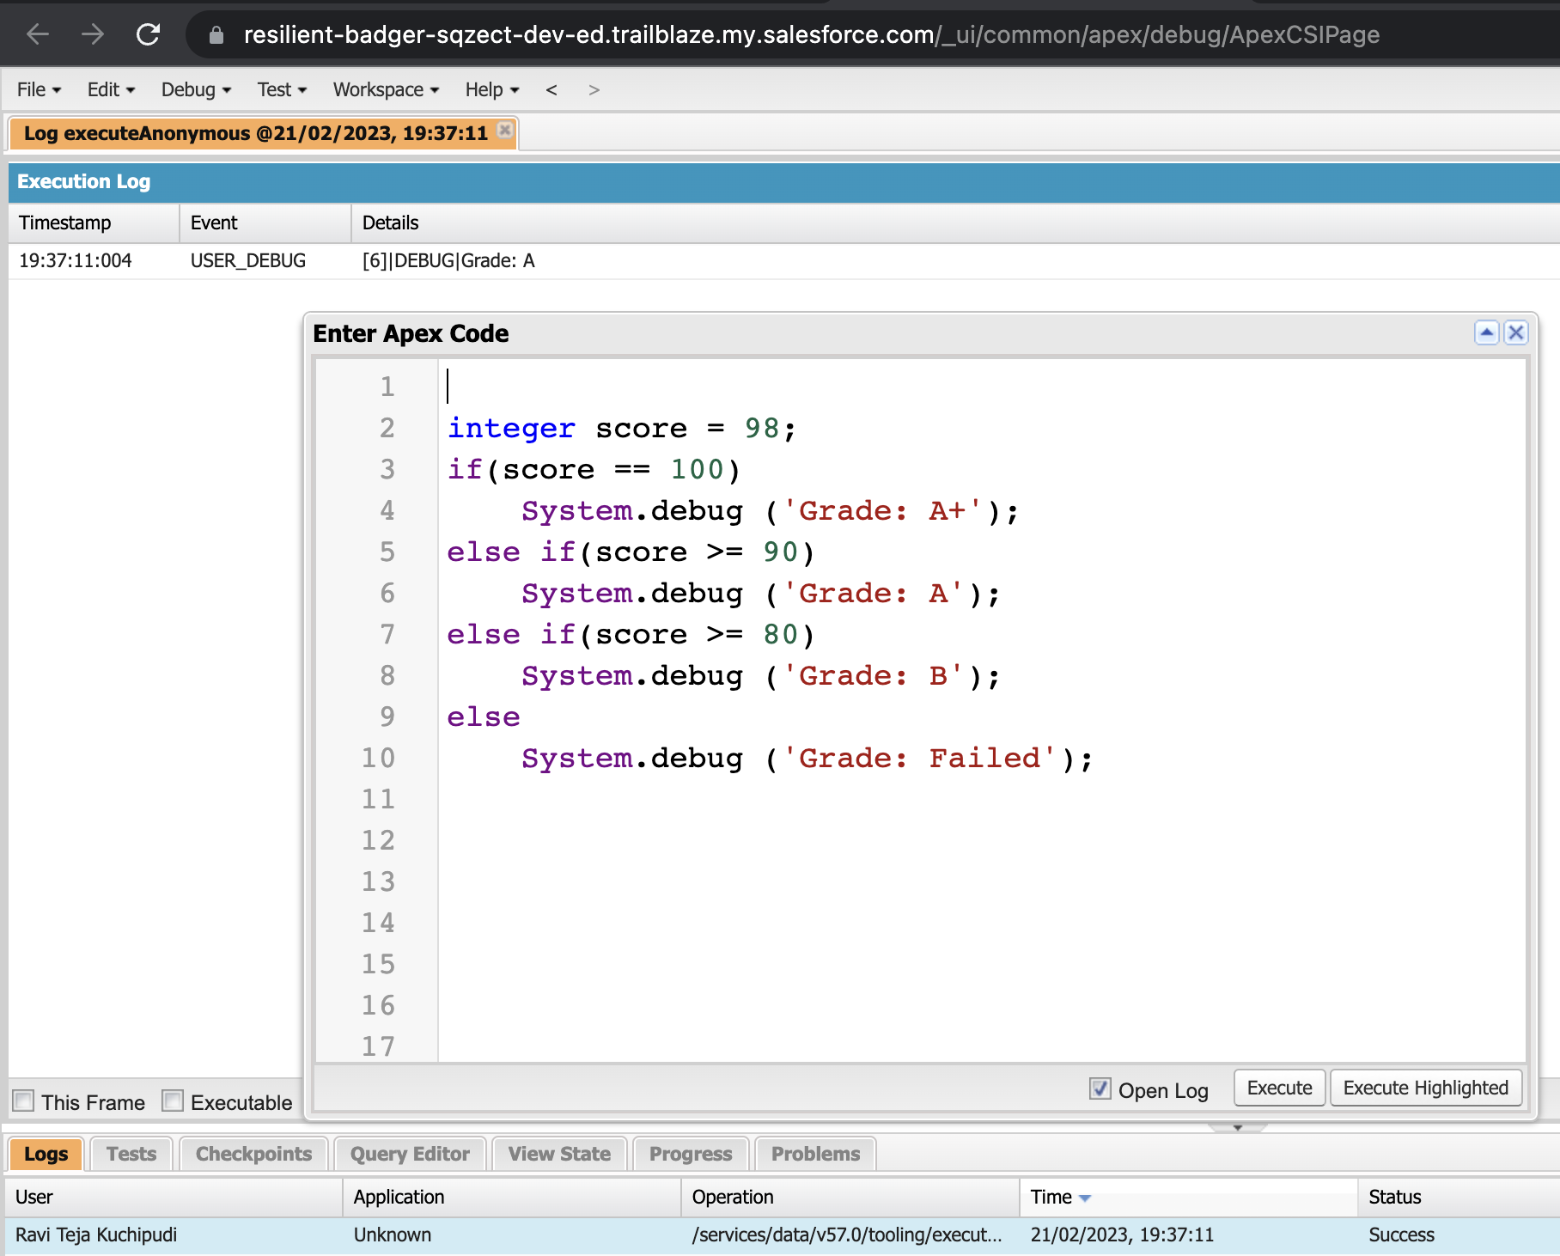
Exercise - 6
Write a program and execute to demo the use of “If..else if...else”
Define an Integer variable called Score.
System.debug (‘Grade: A+’), if Score is equal to 100.
System.debug (‘Grade: A’), if Score is greater than or equals to 90.
System.debug (‘Grade: B’), if Score is greater than or equals to 80.
System.debug (‘Grade: Failed’), define as final else.

Slide 37
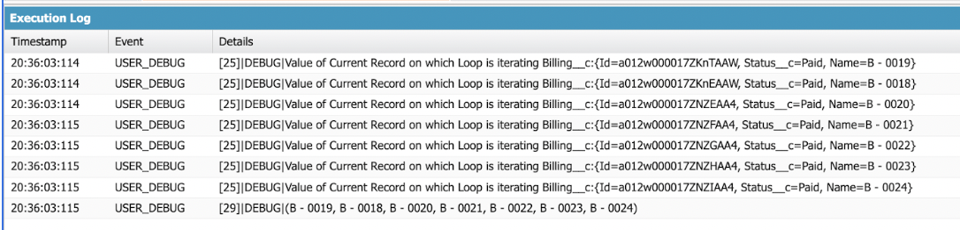
Exercise - 7
Write a program to execute and demo the use of “Apex – for Loop”
Initialize the Billing object list to store the Billing Records created today, use SOQL.
Use for Loop to iterate over the list and check if the Billings status = Paid.
System.debug (‘Value of Current Record in the Loop’+ Billing List);
if Status is paid then add the Billings into a List of String.
System.debug('Value of BillingList '+BillingList);
Note: Create at least 2 Billing records with Status = Paid for this exercise.

Slide 38
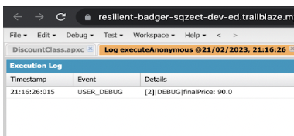
Exercise - 8
Write a Class to demo the use of Constants in Apex:
Class Name = DiscountClass.
Define a Final Decimal variable called “regularDiscount”.
Define a Decimal variable called “finalPrice”.
Define a Method called “calculateDiscount(Integer price)”, takes a Decimal data type.
finalPrice = price - price*regularDiscount;
Don’t forget to return a Decimal data type

Slide 39
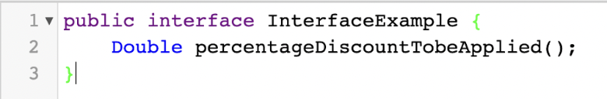
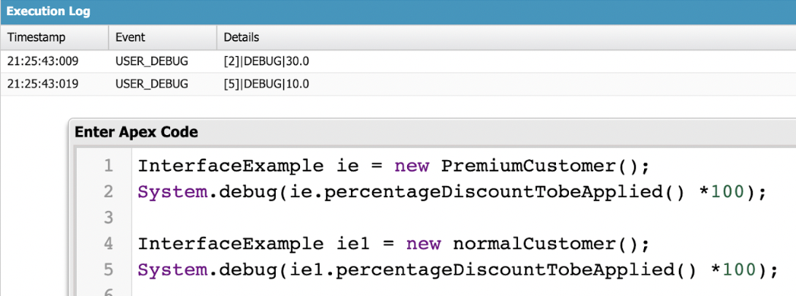
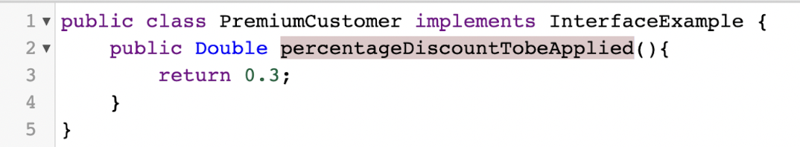

Exercise - 9
Write a Class to demo the use of Interface in Apex.

Slide 40


Exercise - 10
Demo on DML Insert Operation Using Database methods:
Insert a Customer Record First using simple DML Statement.
Insert Billing record using Database methods. So that partial processing is enabled.
Use a List<Billing c> to perform the Database insert method & store the result in srList.
Iterate through the Success/Error result, show inserted record ID, or the error message with fields.

Slide 41

Exercise - 11
Write and execute SOQL queries from Developer Console.

Slide 42



Exercise - 12
Write an Apex Trigger:
Billing Record Should be created when on Customer Object the 'Status' field changes to Active from Inactive

Slide 43

Exercise - 13
Write a Test Class for CustomerTrigger.

Slide 44

Exercise - 14
Write an Apex Trigger:
Define logic to find Leads with ‘Test’ in the Name, Ignore Case.
Validate that the Lead First/Last Name must not be Blank.
Add the disqualified Leads to a List<Lead>, use for loop to iterate through the list and update Lead status field to ‘Disqualified

Slide 45

Exercise - 15
Write a Test Class for DisqualifyTestLeads:

Slide 46

Exercise - 16
Create a Visualforce page which displays Opportunity fields as output fields:

Slide 47


Exercise - 17
Create a Visualforce page which shows a list of Accounts linked to their record pages

Slide 48



Exercise - 18
Create a Visualforce page that uses a custom controller to display a list of cases with the status of 'New'.

Slide 49
Thank You

